Slide 2
Muhammad Ahmad Domain Officer, PSW
DIGITAL TRANSFORMATION OF CROSS BORDER TRADE
PAKISTAN SINGLE WINDOW

Slide 3
Sequence
1
Introduction
2
Context
3
Cardinal Principles
4
Pre & Post PSW Environment
5
6
PSW Subscription & KYC
Current & upcoming Services

Slide 4
PAKISTAN SINGLE WINDOW-QUICK FACTS
A category ‘C’ commitment under the WTO (Article 10.4)
Implementation deadline-June 2022
PSW Act notified in April 2021; Pakistan Customs designated ‘Lead Agency’
Pakistan Single Window Company notified as ‘Operating Entity’
Roll out began in July 2021 and Phase 1 of the roll out was completed on 30th June, 2022.

Slide 5
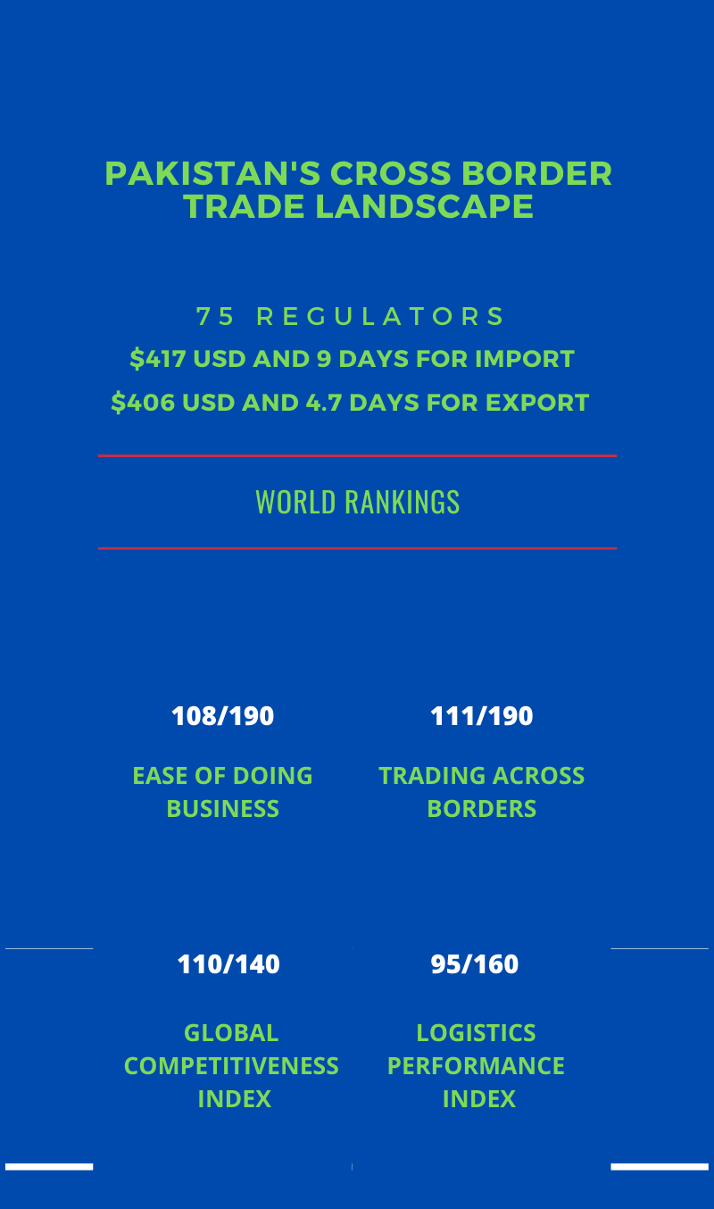
Introduction
Regulations are applied on:
67% of all import goods declarations (GDs)
12% percent of all exports
100% if State Bank’s related Import and Export Forms are taken into account.
2.1 million licenses, permits, certifications and other documents issued on 2.4 million TEUs
Intrusive examinations and sampling by Customs (45%), ANF, and other trade regulators without any risk management and joint inspection mechanism.
Regulations may be at the pre-importation, post-importation or all stages of process
Fragmented, complex regulations/procedures mostly based on manual processes
Consolidated information not available

Slide 6
Cardinal Principles of PSW
Eliminating redundancy & duplication
Least physical engagement among stakeholders
Use of standardized and harmonized data elements
Incremental submission of structured data with parallel processing
Automatic routing & verifications
Real time information exchange

Slide 7
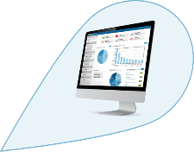
Pre-PSW
Trader
Transport
Customs Agent
Insurance
Shipping Agent
Banks
Customs
Ports
Trade Regulators

Slide 8
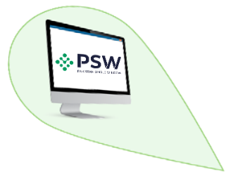
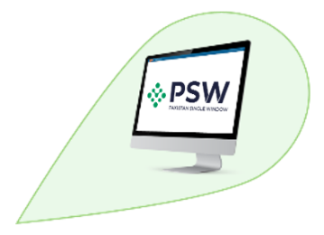
Post-PSW
Trader
Transport
Customs Agent
Insurance
Shipping Agent
Banks
Customs
Trade Regulators
Ports

Slide 9
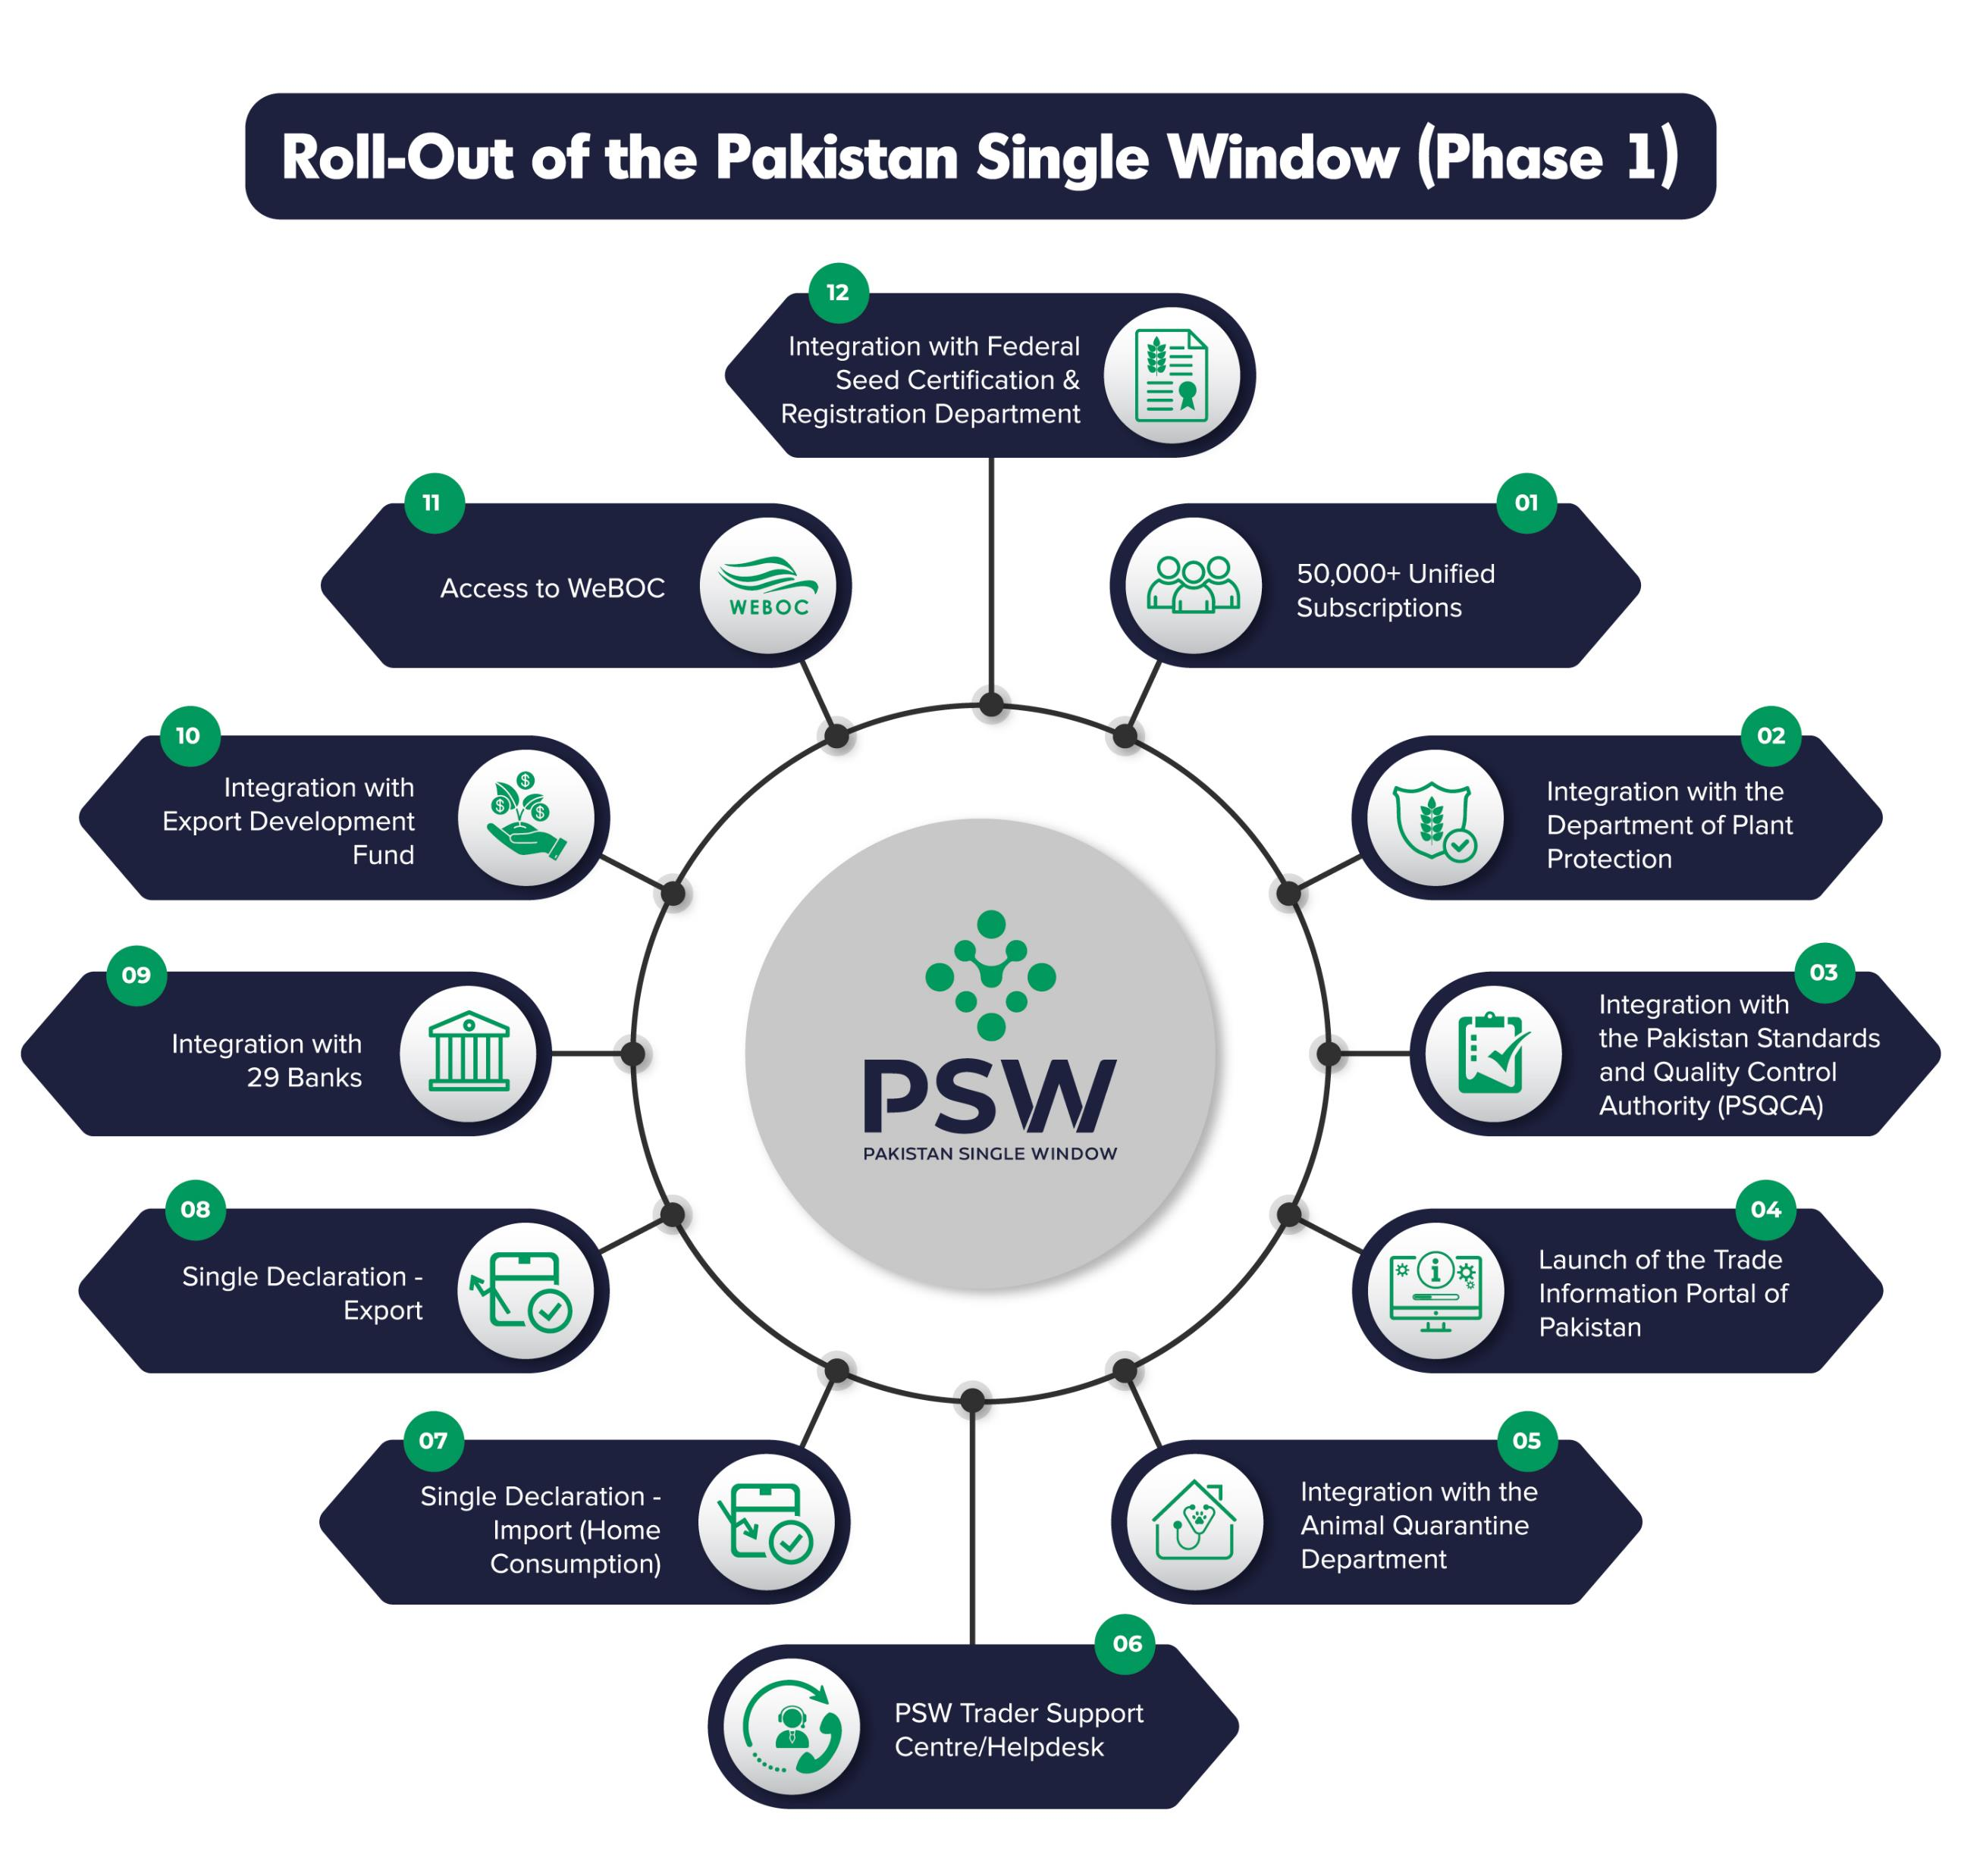
CURRENT SERVICES
Trade Information Portal-TIPP
Integration with Commercial Banks
Integration with:
Customs
DPP
AQD
FSC&RD
EDF
NADRA
PMD
FBR

Slide 10
Process Simplification
Name of Regulator | No. of Processes Re-engineered | Documents Replaced with Electronic Verification | Documents Replaced with Electronic Submission | No. of Documents Eliminated
Department of Plant Protection | 13 | 5 | 6 | 1
Pakistan Standards & Quality Control Authority | 8 | 6 | 5 | 1
Animal Quarantine Department | 8 | 5 | 2 | 1
Federal Seed Certification & Registration Department | 10 | 5 | 5 | 0
State Bank of Pakistan | 9 | 2 | 7 | 2
Business Process re-engineering through removal of redundancy and unnecessary documentation

Slide 11
PSW Features
Single Declaration for Imports and Exports
Data Harmonization
Data Standardization
Single data capturing
Unified Payment System
Universal e payment
B2G, G2B, B2B
Single Experience Payment
Unified Registration System
PSW Subscription
Customs Registration
OGA Business, Product & Premises Registration
Integrated Tariff for Trade
12 Digit Product Codes
Auto routing

Slide 12
PSW Core Services
Integrated Risk Management System
OGA coverage
Blue Channel
User Management System (OGAs)
End to End
Customized MIS
Lab Management System
Complete Solution
E payment
Structured Reports
Trade Information Portal
Digitized customs tariffs and trade statistics
530 regulations from 77 agencies digitized
Access to complete information and LPCOs

Slide 13
UPCOMING SERVICES
E-TRADE
Integration of the Drug Regulatory Authority of Pakistan, Board of Investment, Ministry of Foreign Affairs, and private sector service providers including laboratories, pre-shipment inspection companies, and transporters
SINGLE REGISTRY FOR TRADE
E-registry for businesses, products, and premises will eliminate multiple registration points for Customs and OGAs
INTEGRATED RISK MANAGEMENT SYSTEM
Envisages joint inspections, blue channel facility, and post clearance audits
AIR- AND SEA PORT COMMUNITY SYSTEMS
Integration of all regulatory functions at the port, average time saving of 3 days per consignment, 50 USD per container
TRANSFORMATION OF THE CUSTOMS MANAGEMENT SYSTEM (WEBOC)
Technical and functional upgradation of WeBOC
Notes:
The journey continues with new features, modules, and government departments constantly being added to the PSW system. Two important milestones coming up in a few months is the implementation of the integrated risk management system which will allow risk based treatment of imported cargo by the trade regulators, and the development of the Port Community System to connect all public and private stakeholders at the port.

Slide 14
PSW Subscription and Evidence of Identity (KYC)

Slide 15
PSW Subscription and Evidence of Identity (KYC)
Entity Verification
Mobile Number Verification
Biometric Verification or Physical Verification
Integration with FBR
Validation of NTN
Validation of Ownership
Integration with Pakistan Mobile Number Portability Database
Validation of Mobile Number and CNIC pair
Integration with NADRA BioVerisys system
Two Factor Authentication
OTP verification through verified Mobile Number
OTP verification through email on FBR registered email address
Notes:
To add Registration trader and customs

Slide 16
Bank Profile Association
Two Factor Authentication
OTP verification through provided Mobile Number (as per bank records)
OTP verification through email on provided email address (as per bank records)
Sharing of Trader Profile by AD
Account title
Account status
Authorized mode of Payments for Imports
Authorized modes of Payments for Exports
Bank Information
Bank Name, IBAN, Mobile number (as per bank records) and Email address (as per bank records)
Realtime automated verification of provided information with relevant bank
Two Factor Authentication
OTP verification through provided Mobile Number (as per bank records)
OTP verification through email on provided email address (as per bank records)

Slide 17
EIF/EFE Elimination
All the 29 commercial banks (Authorized Dealers) integrated with PSW
Form-E and Form-I have been eliminated through direct association of FIs
Elimination of 1.5 million forms per annum having average processing time of 2.2 days
Trader’s bank profile validations performed against IBAN on real time basis
Bank’s intervention eliminated in Open Account transactions
Multiple Export consignments allowed against LC and Contract
Real time validations at the time of filing of SD (GD)

Slide 18
Single Declaration (Imports & Exports)
Consolidated Declaration for consumption of Customs (GD) and OGAs (LPCO application)
All data elements for GD and OGA applications are captured at the time of filing of SD
All mandatory documents uploaded with the SD
Relevant data fields/elements are transmitted to Customs and OGAs upon submission
Parallel / simultaneous processing by Customs and OGAs
So far, around 3000 SDs have been filed and processed through PSW system

Slide 19
Trade Information Portal of Pakistan (TradeVerse)
Successfully rolled-out TIPP on 31, March, 2022 as under article 1.2 of the WTO’s TFA
Digitized customs tariffs and trade statistics with the latest and current data based on 9.2 million transactions; available both in English and Urdu languages
Facilitates cross-border trade by providing complete trade-related information and guidance to individuals and businesses engaged in cross-border trade
Over 530 laws, regulations, procedures, and other trade-related measures from over 77 government agencies have been completely digitized and can now be accessed online
Businesses can also access/download licenses, permits, certificates, and other documents from the portal and get complete information on applicable fees, processing times, and step-by-step procedures
Access on www.tipp.gov.pk

Slide 20
Change Management
Stakeholders onboarding, awareness, training and feedback given due importance
Vigorous change management activities precede every roll-out
Separate Change Management section established
A well thought out and planned Training strategy being implemented with the help of external partners
User manuals and tutorial videos of various modules prepared before and after deployment

Slide 21
THANK YOU

