Slide 2
PREVENTION OF PESTICIDE RESIDUES IN RICE EXPORTED FROM PAKISTAN
Dr. Mubarik Ahmed

Slide 3
IMPORTANCE OF RICE FOR PAKISTAN’S ECONOMY
After wheat, rice is the second staple crop
It is the second most exportable commodity, the first being cotton
In 2021-2022 rice production equaled 9.32 million tons that declined to 7.32 million tons in 2022-2023. The decline was due to flooding in Sindh.
Pakistan is the 10th largest producer of rice and 4th largest exporter of rice
Pakistan is the largest exporter of rice in EU and export rice worth about 405 million USD

Slide 4
Major Pakistani Rice Importing Countries
S. No | Basmati Rice | Non-Basmati Rice
1 | UAE | China
2 | UK | Kenya
3 | Oman | Ivory Coast
4 | KSA | Mozambique
5 | Belgium | Malaysia
6 | Yemen | Tanzania
7 | Spain | Indonesia
8 | Azerbaijan | Madagascar
9 | Italy | Senegal
10 | Qatar | Azerbaijan
Source: Rice Exporters Association of Pakistan (REAP)

Slide 5
Key Parameters of Production
Cultivation of improved varieties
Timely sowing and harvest
Weed control
Proper management of crop density
Proper and timely application of fertilizer
Proper and timely management of water
Pest control
Proper and timely harvest and post-harvest management of paddy
Mechanization of cultivation practices

Slide 6
Pest Management in Rice
The management scheme should be SAFE for humans, animals and the environment.
Insect management
Disease management (includes fungal, bacterial and viral diseases)
Weed management

Slide 7
Major Insect Pests of Rice
Yellow Stem Borer
White Stem Borer
White-backed plant hopper
Rice leaf roller/folder
Rice grasshopper
Small grasshopper

Slide 8
Minor Insect Pests of Rice
Pink stem borer
Green leafhopper
Paddy white leafhopper
Rice bug
Green stink bug
Black paddy bug
Rice army worm
Paddy swarming caterpillar
Paddy cutworm
x. Cotton cutworm
xi. Rice caseworm
xii. Rice skipper butterfly
xiii. Short-horned grasshopper
xiv. Mole cricket
xv. Paddy soot fly
xvi. Rice gall midge
xvii. Rice thrips

Slide 9
Major Diseases of Rice
Rice Blast
Rice Sheath Blight
Bacterial Leaf Blight
Rice False Smut
Rice Bakanae Disease
Rice Brown Spots
Bacterial Sheath Brown Rot

Slide 10
Registered Pesticides For Rice
Pesticides | Total Number | No. of Pesticides Marketed as Mixtures
Insecticides | 50 | 28
Fungicides | 36 | 18
Herbicides | 47 | 28
Bio pesticides | 2 | -
Molluscide | 1 | -
Others | 3 | -
Total | 139 | 74

Slide 11
Interception of Pakistan Rice Consignments by EU and US
Pesticides | No. of Notifications | Percentage
Carbendazim (MBC) | 51 | 31.7
Tebuconazole | 31 | 19.2
Chlorpyrifos | 17 | 10.6
Difenoconazole | 17 | 10.6
Acetamiprid | 15 | 9.3
Triazophos | 11 | 6.8
Imidacloprid | 9 | 5.6
Pirimiphos-Methyl | 4 | 2.5
Isoprothiolane | 2 | 1.2
Clothianidin | 1 | 0.6
Profenofos | 1 | 0.6
Thiamethoxam | 1 | 0.6
Thiophanate-Methyl | 1 | 0.6

Slide 12
Available Options To Tackle The Problem
Judiciary use of pesticides keeping in view the following
To strictly follow the Pre-Harvest Intervals (PHI) of different pesticides and observe WHO Toxicity Classifications
To avoid pesticides that were found to have exceeded MRLs
Switching to IPM approach instead of totally relying on chemicals
Not to apply pesticides that are not registered for rice
Ensure proper dosage and calibration of spraying equipment

Slide 13
Key principles for selection of pesticides for prevention / control of pest and diseases
Use pesticides that are registered for rice.
Preharvest interval should be strictly followed.
Pesticide should be safe considering WHO classification.
Avoid pesticides that become a cause of rejection/interception.

Slide 14
WHO Toxicity Classes
Ia – Extremely Hazardous
Ib – Highly Hazardous
II – Moderately Hazardous
III – Slightly Hazardous
U – Unlikely to Present Acute Hazard
M – Fumigant
O – Obsolete

Slide 15
Pre-harvest interval
The preharvest interval (PHI) in agriculture refers to the minimum amount of time that must pass between the last application of a pesticide or other agricultural chemical and the harvest of the crop. It is a critical consideration to ensure that the produce is safe for human consumption and meets regulatory standards for pesticide residue levels.
The PHI is determined by the pesticide manufacturer and is typically specified on the product label. It takes into account factors such as the chemical's degradation rate, absorption by the plant, and the potential health risks associated with consuming the crop shortly after pesticide application. Different pesticides have varying PHIs, which can range from a few days to several weeks or even months.

Slide 16
Importance of Pre harvest interval
Farmers and growers must adhere to the specified PHI to comply with food safety regulations and minimize the risk of pesticide residues exceeding acceptable levels.
Failure to observe the required interval may result in contaminated produce that is unsafe for consumption or may lead to regulatory penalties and market access restrictions.

Slide 17
Pre-harvest Interval (PHI) of Insecticides Registered For Rice
Product | Formulation | PHI (D)
Abamectin + Methoxyfenozide | 10%SC | 7-10
Abamectin + Thiamethoxam | 12% SC (2% + 10%) | 14
Abamectin + Triazophos | 20% EC (0.3% + 19.7%) | 30
Buprofezin | 25% EC, 25% WP | 14
Buprofezin + Abamectin | 15% WP (14.85% + 0.15%) Tech. (97% + 92%) | 14
Buprofezin + Acephate | 50% WP (15% + 35%) | 10
Buprofezin + Isoprocarb | 25% WP (5% + 20%) | 21
Buprofezin + Metolcarb | 25% WP (5% + 20%) | 25
Buprofezin + Nitenpyram | 70% WG (60% + 10%) | 14
Carbosulfan | 20% EC (21.6% w/w), 20% ULV & 88% Tech. | 30
Cartap Hydrochloride | 4% G, 8% G, 95% SP | 30-40
Product | Formulation | PHI (D)
Chlorfenapyr + Spinosad | 13% SC (10.5% + 2.5%) & Tech. (Chlorfenapyr 98% + Spinosad 92%) | 14
Clothianidin | 20% SC, 50% WDG | 21
Clothianidin + Pymetrozine | 30% WDG (5% + 25%) & Tech. (98% + 98%) | 21
Dinotefuran + Pymetrozine | 70% WG (35% + 35%) | 14
Emamectin Benzoate + Indoxacarb | 9% SC | 28
Emamectin Benzoate + Lambda-Cyhalothrin | 12% WP (2% + 10%) & Tech. (Emamectin Benzoate 90% + Lambda-Cyhalothrin 95%) | 7-10
Fenobucarb | 25% EC & 97% Tech. | 7-10
Fenobucarb + Buprofezin | 25% SE (20% + 5%) | 10-15
Fipronil | 5% SC | 25-35
Lambda - Cyhalothrin | 2.5% EC | 7
Matrine | 0.3%AS | 7
Methoxyfenozide + Abamectin | 10% SC (8% + 2%) & Tech. (Methoxyfenozide 98.5% + Abamectin 93%) | 7-10
Product | Formulation | PHI (D)
Monomehypo | 5% G, 10% G, 3.6% G | 30-40
Nitenpyram + Pymetrozine | 80% WDG (20% + 60%) | 30
Permethrin | 25 EC & 0.5 % Powder & 90% Tech. | 10
Pymetrozine | 25% SC & 50% WG | 11
Pymetrozine + Buprofezin | 50% WDG (17% + 33%) | 10-12
Pymetrozine + Chlorpyrifos | 30% WP (10% + 20%) | 10-15
Pymetrozine + Dinotefuron | 60% WG (20% + 40%) | 7-9
Thiamethoxam | 25% WG | 10
Thiamethoxam + Buprofezin | 24% WP (4% + 20%) | 10-14
Thiamethoxam + Nitenpyram | 50% WDG (30% + 20%) & Tech. (98% + 97%) | 7-14
Thiocyclam Hydrogen Oxalate | 50% SP & 90% Tech. | 12
Flonicamid | 50% WG | 3
Imidacloprid | 25% WP 5% EC, 70% WG, 200 SC | 7-14

Slide 18
Pre-harvest Interval (PHI) of Fungicides Registered For Rice
Product | Formulation | PHI (D)
Azoxystrobin | 25% SC | 28
Azoxystrobin + Difenoconazole | 32.5% SC (20% + 12.5%) | 5-7
Azoxystrobin + Flutriafol | 25% SC (125 g/l + 125 g/l) | 30
Azoxystrobin + Propiconazole | 32% SC (20% + 12%) | 28
Azoxystrobin + Tebuconazole | 50% SC (20% w/v + 30% w/v) | 35
Benzisothiazolinone | 3% ME | 7-10
Carbendazin + Tebuconazole | 60% WG & Tech. (98% + 97%) | 7-10
Flutriafol + Tebuconazole | 30% SC (75g/l + 225 g/l) | 10-20
Product | Formulation | PHI (D)
Iprobenfos | 50% EC & 40% EC | 21
Isoprothiolane | 40%EC | 14
Jingangmycin A + Tebuconazole | 17% SC (12% + 5%) | 7-10
Kasugamy cin + Triey clazde | 13% WP (3% + 10%) | 7-10
Kasugamycin | 4% WP & 55% Tech. | 21
Kasugamycin + Copper Oxychloride (Castle) | 50% WP (5% + 45%) & Tech. (Kasugamycin 65% + Copper Oxychloride 90%) | 21
Kasugamycin + Tricyclazole | 13% WP (3% + 10%) & Tech. (Kasugamycin 55% + Tricyclazole 95%) | 7-10
Kresoxim-Methyl + Fenoxanil | 26% SC & 95% + 96% Tech | 21
Propiconazole (Tilt) | 250 EC & 94% Tech. | 12
Product | Formulation | PHI (D)
Sulphur (Thiovit Jet & Sulfex Gold) | 80% WDG | 10-20
Thifluzamide | 24% SC & 98% Tech. | 10
Thifluzamide + Thiophanate Methyl | 50% SC (15% + 35%) & Tech. (96% + 95%) | 10-15
Thifluzamide + Trifloxystrobin | 40% SC (20% + 20%) & Tech. (95% + 97.5%) | 10-13
Trifloxystrobin + Tebuconazole | 75% WG (250 g/kg + 500 g/kg) | 9-13
Triflumizole (Trifmine) | 15% EC & 97% Tech. | 11
Validamycin | 10% SL & 60% TK | 11
Validamycin + Epoxiconazole | 24% SC (16% + 8%) | 8-15
Thiophanate Methyl | 70 WP, 40% ULV | 8-15

Slide 19
Pre-Harvest Interval (PHI) of Herbicides Registered For Rice
Product | Formulation | PHI (D)
Acetochlor + Bensulfuron Methyl | 20% WP (15.5% + 4.5%) & Tech. (92% + 97%) | 5-12
Bensulfuron Methyl + Acetochlor | 16%KPP | 5-12
Bensulfuron Methyl + Butachlor | 30% WP | 5-8
Bensulfuron Methyl + Pretilachlor | 30% EC (2% + 28%) | 2-4
Bensulfuron Methyl + Quinclorac | 25% SC (3% + 22%) & Bensulfuron Methyl 96% Tech. & Quinclorac 96% Tech. | 3-5
Bentazone | 48% SL & 96% Tech. | 15-30
Bispyribac Sodium | 2% SL, 10% SC, 20% WP, 40% SC | 4-5
Bispyribac Sodium + Bensulfuron Methyl | 30% WDG (18% + 12%) & 30% WP (18% + 12%) | 7-10
Butachlor | 60% EC, 90% EC 60% EW | 5-7
Cinosulfuron | 10% WP & 92% Tech. | 4-10
Cyhalofop Butyl | 10% EW | 7
Cyhalofop Butyl + Bispyribac Sodium | 16% OD (12% + 4%) | 1-2
Product | Formulation | PHI (D)
Cyhalofop Butyl + Penoxsulam + Bensulfuron-methyl | 21% OD (12.5% + 3.5% + 5%) | 5-7
Fenoxaprop-p-ethyl + Penoxsulam | 10% OD (4% + 6%) | 5-7
Fluroxypyr | 20% EC & 95% Tech. | 10
Glyphosate Isopropylammonium | 41% SL | 5
MCPA-Sodium + Carfentrazone Ethyl | 70.5% WP (66.5% + 4%) | 30
Oxadiazon | 12 EC, 25% EC | 25
Oxadiazon + Butachlor | 60% (10% + 50%) & Tech. (98% + 94%) | 30
Oxadiazon + Oxyfluorfen | 14% EC (10% + 4%) & Tech. (Oxadiazon 98% + Oxyfluorfen 97% ) | 2-7
Penoxsulam + Bispyribac Sodium + Cyhalofop-Butyl | 14% OD (1.5% + 2% + 10.5%) | 5-7
Penoxsulam + Cyhalofop-Butyl | 60% OD (10 g/l + 50 g/l) | 10
Penoxsulam + Pyrazosulfuron-Ethyl | 4% OD (2% + 2%) | 15
Pretilachlor | 2 G, 500 EC, 30% EC | 13
Pretilachlor + Bensulfuron Methyl | 35%WP & Tech (Pretilachlor 96% + Bensulfuron Methyl 96%) | 11-15
Product | Formulation | PHI (D)
Pretilachlor + Oxadiargyl | 32% WP (24% + 8%) & Tech. (98% + 96%) | 14
Propanil | 360 EC & 97% Tech. | 10-15
Propanil + Clomazone | 39%EC & Tech(Propanil 95% + Clomazone 96%) | 13
Pyrazosulfuron Ethyi + Bispyribac Sodium | 30% WP 98% + 98% Tech | 10
Pyrazosulfuron ethyi +Pretilachlor | 6.15%GR, 16.5% PP, 35% WP | 11
Pyrazosulfuron Ethyl | 10% WP & 10% WDG | 9
Pyrazosulfuron Ethyl + Carfentrazone Ethyl | 30% WP (25% + 5%) | 10
Pyrazosulfuron Ethyl + Pretilachlor + Clomazone | 38% WP (2% + 26% + 10%) | 11
Pyrazosulfuron Ethyl + Quinclorac | 50% WP (3% + 47%) & Pyrazosulfuron Ethyl 95% Tech. & Quinclorac 90% Tech. | 10-14
Pyrazosulfuron-ethyl + Cyhalofop-buptyl | 15%WP & Tech(Pyrazosulfuron-ethyl 97% + Chyalofop-buptyl 98%) | 10-16
Pyrazosulfuron-ethyl + Oxadiargyl | 24% OD (8% + 46%) & Tech. (Pyrazosulfuron-ethyl 98% + Oxadiargyl 96%) | 10-14
Pyriftalid + Bensulfuron-Methyl | 55.8% SC (36.6% + 18.48%) | 13
Quinclorac | 50% WP & 90% Tech. | 9

Slide 20
Integrated Pest Management Approach To Control Important Insects and Diseases of Rice

Slide 21
What is integrated pest management?
Integrated Pest Management is a broad-based and environment-friendly approach that integrates both chemical and non-chemical methods for economic control of pests and to keep it below economic injury level.
It combines biological, cultural, physical and chemical control methods to minimize economic, health and environmental risks.

Slide 22
Five components of integrated pest management
Taking no action
Use of cultural practice
Mechanical control
Biological control
Chemical control

Slide 23
major characteristics of IPM
Pest identification
Monitoring pest number and damage
Develop guide line for action
Preventing pest population
Using one or more combination of techniques to include biological, cultural, physical, mechanical and chemical
Assessment

Slide 24
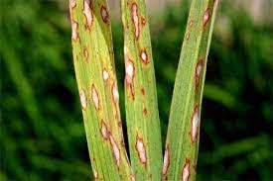
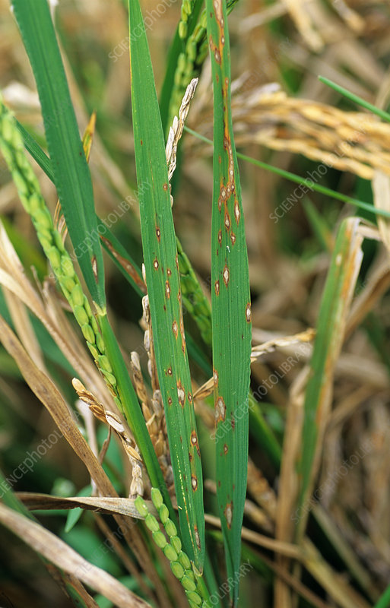
Integrated Management of Rice Blast (Magnaporthe oryzae)
Importance/Symptoms
Cultural/Management
Most destructive pathogen
Attacks all parts above ground
Eye shaped spots on leaves
Widely spread in Pakistan
Occurs in areas with low soil moisture and prolonged rains
Symptoms include node infection in banded pattern
Cultivating susceptible varieties
Remove stubbles at earliest
Avoid late planting
Soil should remain flooded 2-4 inch until plants are 6-8 inch tall
Avoid excess nitrogen application
Neem and Garlic extract are effective
Field hygiene
Weed management
Adjusting planting time
Chemical Control
Pesticides Exceeding MRL’s
Azoxystrobin (U)
Iprobenfos (II)
Isoprothiolane (II)
Kasugamycin (U)
Kasugamycin + Oxychloride
Kasugatity Chloride Hydrate
Kresoxim-Methyl (III)
Triflumizole
Azoxystrobin + Flutriafal (U + II)
Azoxystrobin + Difenoconazole (U + II)
Difenoconazole + Validamycin ( II + U)
Sulphur + Carbendazim (III + II)
Thiophenate Methyl (U)
Tricyclazole (II)
Tricyclazole + Validamycin (II + U)
Trifloxystrobin + Tebuconazole (U + II)
Kasugamycin + Tricyclazole ( U + II )

Slide 25
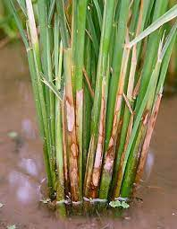
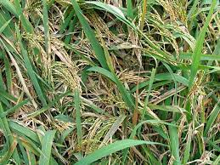
Integrated Management of Rice Sheath Blight (Rhizoctnia solani)
Importance/Symptoms
Cultural/Management
Soil borne fungi
Spores can survive 2 years under unfavorable conditions
Symptoms include formation of lesions leading to stem lodging
Lesions normally start from the leaf margins with wavy appearance
It has been reported in all parts of Pakistan
Keep field clean
Use disease resistant cultivars
Increases with overdosing of Nitrogen
Use of healthy seeds
Removal of stubble, straw and weeds
The disease is spread from the weeds in rice field
Chemical Control
Pesticides Exceeding MRL’s
Azoxystrobin + Flutriafol (U + II)
Azoxystrobin + Propiconazole (U + II)
Iprobenfos (II)
Kasugamycin (U)
Kasugamycin + Methyl Fenoxanil
Thifluzamide (U)
Thifluzamide + Thiophanate Methyl (U + U)
Thifluzamide + Trifloxystrobin (U + U)
Validamycin (U)
Azoxystrobin + Difenoconazole (U + II)
Azoxystrobin + Tebuconazole (U + II)
Tricyclazole + Validamycin (II + U)
Trifloxystrobin + Tebuconazole (U + II)

Slide 26
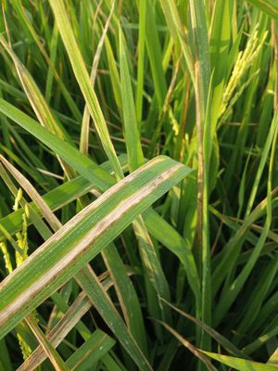
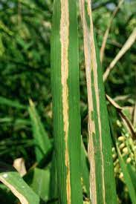
Integrated Management of Bacterial Leaf Blight (Xanthomonas oryzae)
Importance/Symptoms
Cultural/Management
Lemon-colored irregular-shaped patches
Disease starts from the lower region and travels upwards
May result in complete drying of leaves (Kresek phase)
Use resistant varieties
Balanced nutrition
Good drainage
Field Hygiene
Keeping pH alkaline using bleach
Removing weeds
Plough under rice stubbles
Chemical Control
Pesticides Exceeding MRL’s
Benzisothiazolinone (U)
Zinc thiazole (bactericide)
Kresoxim Methyl + Fenoxilin ( III + U )
Jingangmycin + Tebuconazole (U + II)

Slide 27
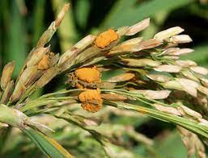
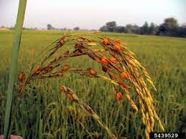
Integrated Management of False Smut (Ustilaginoidea virens)
Importance/Symptoms
Cultural/Management
Causes chalkiness in grains and results in reduction in grain weight
Occurs in humid areas temperatures between 25-35 C
Velvety smut balls on spikelet
Infest early flowering stage and also when spikelet reach maturity
Does nor produce ergot
Keep the field clean
Removal of plant debris after harvest
Adopt alternate wetting and drying instead of continuous flooding
Don’t use excess nitrogen
Use certified seeds
Heat treatment of seeds before sowing
Use of resistant varieties
Planting rice earlier
Chemical Control
Pesticides Exceeding MRL’s
Carbendazim + Tebuconazole ( II + II)
Jingangmycin + Tebuconazole (U + II)

Slide 28
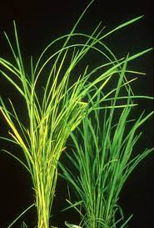
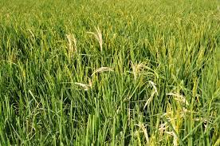
Integrated Management of Bakanae Disease (Gibbella fujikuroi)
Importance/Symptoms
Cultural/Management
Use clean seed
Separate lightweight seeds using saline water
Burn plant residues
Seed treatment
Seed borne fungi
Infest after a month of planting
Infected plants are taller than the rest
On maturity infected plants tilt at the top
Chemical Control
Pesticides Exceeding MRL’s
Fludioxonil (U)
Fludioxonil + Metalaxyl – M (U + II )
Thiophanate Methyl (U)
Triflumizole (II)
NIL

Slide 29
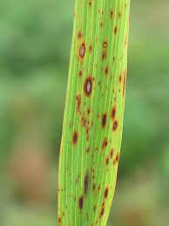
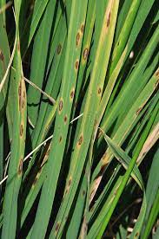
Integrated Management of Rice Brown Spots (Cochilobotus miyabeanus)
Importance/Symptoms
Cultural/Management
Characterized by brown spots in all parts of plant
Infest leaves, leaf sheath, panicle, branches, glumes and spikelets.
Treat seed with hot water
Seed treatment
Nitrogen deficiency increases the disease
Using resistant varieties
Chemical Control
Pesticides Exceeding MRL’s
Kasugamycin Hydrochloride Hydrate (U)
Propiconazole (II)
Sulphur ( III )
Triflumizole ( II)
Tebuconazole + Flutriafal (II)
Trifloxystrobin + Tebuconazole ( U + II)
Difenoconazole + Propioconazole (II + II)

Slide 30
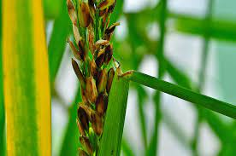
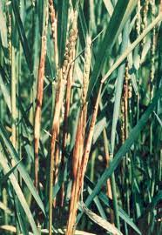
Integrated Management of Bacterial Sheath Brown Rot (Pseudomonous fuscovaginae)
Importance/Symptoms
Cultural/Management
Causes rotting in sheath and grains
Occurs in high altitude, low temperature and high humidity
Seed borne
Symptoms occur on leaf sheath.
Discoloration at seedling stage with yellow or brown colour
Clean the field
Adjust sowing time
Use fresh seedlings
Treat seed with hot water
Treat seed with fungicide
Chemical Control
Pesticides Exceeding MRL’s
Kasugamycin Hydrochloride Hydrate (U)
Propiconazole (II)
Sulphur ( III )
Triflumizole ( II)
Tebuconazole + Flutriafal (II)
Trifloxystrobin + Tebuconazole ( U + II)
Difenoconazole + Propioconazole (II + II)

Slide 31
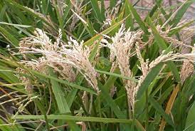
Integrated Management of Stem borrer infestation in rice
(Scirpophaga incertulas, S. innotata, Chilo suppressalis, Sesamia inferens)
Importance/Symptoms
Cultural/Management
S. incertulas (YSB) and S. innotata (WSB) are major pests. The other two are minor.
Can be very destructive with yield loss varying between 5-90%
Hibernates in stubbles and becomes active from mid March to mid May
Infestation starts in nursery and thereafter maximizes
Nursery should not be sown before 20th May and no later than first week of July
Avoid early or late sowing
Harvest close to ground
Destruction of stubbles and burning before February
Flooding of field in Dec-Jan for 5 days and then deep ploughing
Destruction of egg masses
Approved Pesticides
Approved Pesticides
Abamectin + Methoxyfenozide ( Ib + U)
Benfuracarb ( II )
Chlorantraniliprole
Fipronil ( II )
Fipronil + Cartap Hydrochloride ( II + II)
Fipronil + Lambda-cyhalothrin ( II + II )
Flubendiamide ( III )
Lambda-cyhalothrin (II)
Lambda-cyhalothrin + clofentezine (II + III)
Monomehypo ( III )
Spinetoram
Thiocyclam Hydrogen Oxalate ( II )
Pesticides Exceeding MRL’s
Abamectin + Thiamethoxam ( Ib + II)
Abamectin + Triazophos ( Ib + Ib)
Chlorantraniliprole + Thiamethoxam ( U + II )
Chlorpyrifos + Triazophos ( II + Ib)
Triazophos ( Ib)

Slide 32
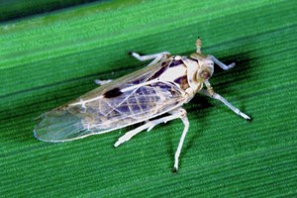
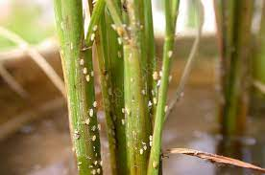
Integrated Management of Whitebacked Planthopper
(Sogottella furcifera and S. catoptron)
Importance/Symptoms
Cultural/Management
They are long winged sucking insects. Adults are light brown to black.
Females are long and short winged. The short wing lays more eggs.
The forewings have a dark brown mark
Leads to yellowing (hopper burns), wilting, stunting with reduced grain production.
Fertilizer management as nitrogen influences host-insect interaction
Potassium deficiency increases the attack
Insect attack increases with stagnant water
Extremely high and low temperatures inhibit the attack
Approved Pesticides
Methoxyfenozide + Abamectin ( U + Ib )
Nitenpyram + Pymetrozine ( II + III )
Pymetrozine (III)
Pymetrozine + Buprofezin (III + III)
Pymetrozine + Dinotefuran (III + III)
Abamectin + Thiamethoxam ( Ib + II )
Pesticides Exceeding MRLs
Clothianidin ( II )
Imidacloprid ( II )
Imidacloprid + Beta-cyfluthrin ( II + Ib )
Pymetrozine + Chlorpyrifos (III + II)
Thiamethoxam ( II ) Thiamethoxam + Buprofezin ( II + III)
Thiamethoxam + Nitenpyram ( II + II )
Buprofezin (III)
Buprofezin + Abamectin ( III + Ib )
Buprofezin + Acephate ( III + II )
Buprofezin + Isoprocarb ( III + II )
Buprofezin + Metolcarb ( III + II )
Buprofezin + Nitenpyram ( III + II )
Carbosulfan ( II )
Chlorofenapyr + Spinosad ( II + III )
Dinotefuran + Pymetrozine ( III + III )
Fenobucarb (II)
Fenobucarb + Buprofezin ( II + III )
Flonicamid ( II )

Slide 33
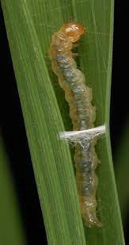
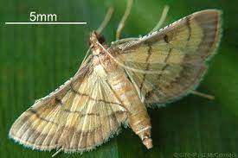
Integrated Management of Rice Leaf Folder
(Cnaphalocrocis medinalis)
Importance/Symptoms
Cultural/Management
Leaffolder caterpillars fold rice leaves around themselves and attach leaf margins with leaf strands
More abundant during rainy season
Resistant to many pesticides
Prefers 45-days old plants
Produces long and transparent whitish streaks on leaves which leads to folding
Heavy fertilizer, high humidity and weeds encourage multiplication of insect
Late sown crop more susceptible
Use of resistant varieties
Spraying pesticides is not recommended during early season
Follow crop rotation
Approved Pesticides
Lambda cyhalohtrin + Clofentazin ( II + III )
Monomehypo
Pyriproxyfen + Emamectin Benzoate ( U + II )
Spinetoram ( U )
Pesticides Exceeding MRLs
Chlorantranipole + Thiamethoxam ( U II )
Deltamethrin + Triazophos ( II + Ib )
Imidacloprid ( II )
Imidacloprid + Beta-cyfluthrin ( II + Ib )
Triazophos (Ib)
Azadirachtin ( U )
Chlorantraniliprole ( U )
Emamectin Benzoate + Indoxacarb ( III + II )
Emamectin Benzoate + Lambdacyhalothrin ( II + II )
Etofenoprox ( U )
Fipronil + Lambdacyhalothrin ( II + II )
Flubendiamide ( III )
Gamma cyhalothrin
Lambda cyhalothrin ( II )

Slide 34
Rejection of rice consignments due to pesticide residues
Rejection of rice consignments due to pesticide residues

Slide 35
Technical Details of Pesticides Exceeding MRL in US and EU
Pesticide | No. of Registered Products | No. of mixtures | No. of products registered for rice | Formulation | MRL (EU) mg/kg | WHO Toxicity Class | PHI (days ) | No. of consignments intercepted | Remarks
Fungicide
Carbendazim | 41 | 3 | 2 | WG, SC, DF, WDG | 0.01 (Reproductive Toxicity) | U | 28 | 51 | To be stopped for use in rice
Tebuconazole | 70 | 63 | 36 | WG, EC, ME, FS, SC, WP | 1.5 | II | 30 | 31 | To be stopped for use in rice
Difenoconazole | 94 | 9 | 6 | EC, WDG, SC, WP, FS | 3 | II | 25 | 17 | To be used very carefully following PHI
Thiophanate- Methyl | 154 | 1 | 150 | WP, WDG, A, ULV | 0.01 | U | 10-15 | 1 | To be used carefully
Tricyclazole | 36 | 30 | 36 | WP, SE, SC | 0.01 | II | NA | 1 | To be used very carefully following PHI
Insecticide
Chlorpyrifos | 369 | 12 | 1 | EC, ULV, EW, G | 0.01 | II | 28 (Soy beans) | 17 | To be stopped for use in rice
Acetamiprid | 738 | 2 | 0 | SP, SC, WP, WDG, EC | 0.01 | II | Not recommended for rice | 15 | Not Registered for rice
Triazophos | 301 | 97 | 293 | EC | 0.02 | Ib | 30 | 11 | To be stopped for use in rice
Imidacloprid | 627 | 14 | 548 | WG, SC, OD, WP, WS, SL | 1.5 | II | 7-14 | 9 | To be used very carefully following PHI
Pirimiphos Methyl | - | - | - | - | 0.5 | - | NR | 4 | No more marketed in Pakistan
Isoprothiolane | - | - | - | - | 6 | - | NR | 2 | No more marketed in Pakistan
Clothianidin | 72 | 15 | 39 | SC, WDG, G | 0.5 | II | 21 | 1 | To be used carefully
Profenofos | 233 | 82 | 0 | EC, ULV | 0.01 | II | NR | 1 | Not Registered for Rice
Thiamethoxam | 80 | 5 | 70 | WG, G, SC, WS, FS, WDG | 0.01 | II | 14 | 1 | To be used very carefully

Slide 36
Summary of MRL values of Pesticides that led to Alert Notifications
S.No | Pesticide Name | Pesticide | Husked rice (mg/Kg) |  |  |  |  |  |  | Polished rice (mg/Kg)
 |  |  | EU | BC Global | CODEX | AUS | CFDA | ASEAN | Philippines | CODEX | AUS | CFDA
1 | Carbendazim¹ | Fungicide | 0.01 |  | 2 | 2 |  | 2 | 0.5 |  |  | 2
2 | Tebuconazole | Fungicide | 1.5 |  |  |  | 0.5 |  | 1.5
3 | Difenoconazole | Fungicide | 3 | 7 |  |  | 3 |  | 0.5 | 0.7
4 | Thiophanate Methyl | Fungicide | 0.01 |  |  |  | 1 |  | 1
5 | Tricyclazole | Fungicide | 0.01 | 3
6 | Triazophos | Insecticide | 0.02 |  |  |  | 0.05 |  |  | 0.6
7 | Imidacloprid | Insecticide | 1.5 |  |  |  | 0.05 |  | 1
8 | Thiamethoxam | Insecticide | 0.01 | 0.02 |  |  | 0.1 |  | 0.5
9 | Chlorpyrifos² | Insecticide | 0.01 | 6 |  |  | 0.5 |  | 0.5
10 | Clothianidin | Insecticide | 0.5 | 0.5 |  |  | 0.2
11 | Isoprothiolane³ | Insecticide | 6.0 |  | 6.0 |  |  |  |  | 1.5 |  | 1.0
12 | Pirimiphos-Methyl³ | Insecticide | 0.5 |  |  | 2.0 | 1.0 |  |  |  | 1.0 | 1.0
13 | Profenofos⁴ | Insecticide | 0.01 |  |  |  | 0.02
14 | Acetamiprid⁴ | Insecticide | 0.01 |  |  |  | 0.5
Only 2 formulations out of 41 are registered for use in rice
One formulation out of 369 is registered for use in rice
No longer marketed in Pakistan
Not registered in Pakistan for use in rice

Slide 37
Permissible Pesticides for Use in Rice by EPA/FDA
Insecticides
1 | Buprofezin
2 | Chlorantraniliprole
3 | Clothianidin
4 | Fipronil
5 | Flubendiamide
6 | Thiamethoxam
Fungicides
1 | Azoxystrobin
2 | Difenoconazole
3 | Fludioxonil
4 | Propiconazole (Tilt)
5 | Tricyclazole
Herbicides
1 | Clomazone
2 | Fluroxypyr
3 | Propanil
4 | Penoxsulam (Ryzelan)
5 | Quinclorac

Slide 38
Conclusion
There is a need to initiate regular survey and monitoring of pesticide residues in agricultural products
The Federal and Provincial pesticide residue testing laboratories need to be strengthened
There is a need to educate farmers for the implementation of Integrated Pest Management Approach and judiciary use of pesticides
There is need to educate farmers on pesticide toxicity in order to prevent any harm to human or animal life as well as the environment
All the pesticides should be used while strictly following their Pre-Harvest Interval (PHI)
There is a need to initiate the determination of Pre-Harvest Interval under local agro-ecological conditions
Mechanism should be established to prevent the use of Carbendazim, Tebuconazole, Triazophos, Chlorpyrifos (Registered for use in rice) and stop the use of Acetemaprid and Profenofos (Not Registered for use in rice).
The use of Difenaconazole and Tricyclazole should be very carefully done observing the Preharvest Intervel. These products should not be delisted as they are approved by EPA/FDA. Use of imidacloprid should also be done very carefully as it may create problems if mis-used

Slide 39
Recommendations
RECOMMENDATIONS

Slide 40
Federal Government
To deregulate the use of Carbendazim, Tebuconazole, Triazophos, Chlorpyrifos in rice due to food safety concerns or develop policy for their judiciary use.
To impose penalty on the misuse of pesticides on non-target crops that are not approved by the Department of Plant Protection. This includes Acetamiprid and Profenofos.
To sensitize the pesticide importers, formulators, distributors and relevant stakeholders on the importance of MRL for protecting the health of local communities and protecting Pakistan’s rice exports and order them to initiate the determination of PHI under local conditions.
The Federal government should facilitate the establishment and strengthening of two pesticide residue testing laboratories: one in Islamabad and the other in Karachi.

Slide 41
Provincial Governments
To promote Integrated Pest Management and judiciary use of pesticides in the rice ecosystem to prevent the harmful effects of pesticides on humans and the environment.
Pesticide restricted/controlled zones may be developed in the provinces to manage exports to the USA that only allow 16 of the 139 registered pesticides for use on rice crop.
The use of pesticides on non-target crops/pests should be taken very seriously and penalties should be imposed on misuse.
Up till the time the Federal Government takes a decision on deregulating Carbendazim, Tebuconazole, Triazophos and Chlorpyrifos, restrict their application on rice with immediate effect or ensure its judiciary use.
To carefully monitor the use of Difenoconazole, Tricyclazole and Imidacloprid, and issue instructions for its judiciary use in rice
Regular surveys should be initiated to monitor the pesticide residues in agricultural products.
Some systems be designed to ensure that the Pre-Harvest Interval (PHI) is followed by the farmers.

Slide 42
Rice Exporters Association of Pakistan (REAP)
To promote the judiciary use of pesticides, the REAP members may consider providing a premium price to farmers as an incentive for not using the unrequired pesticides.
To initiate contractual farming between exporters/processors and farmers to manage the MRL issue

