Slide 1

SGS Connectivity & Products
Connectivity
Presenter’s name
Date | Location
Notes:
Find an image with less elements. Add the gradient shape above the image to make texts more readable

Slide 2

You have challenges
Ensure compliance with applicable legislation
The safety and compliance aspects of electronics have significant legal and commercial impacts on your products.
Chemistry regulations are complex and vary by region.
Quality, safety, and labelling requirements for these products differ according to the country of distribution. Understanding the regulatory framework and your obligations is a critical success factor.
Security evaluation of various IT products
Maintain your competitiveness among international companies
Ensure that your products reach the market quickly
Protect your brand and reduce the risk of costly legal actions
Improve efficacy and trouble-shoot for problems
Gain a deeper understanding of the IoT landscape and the future of electronics

Slide 3

We provide solutions.
Testing & Certifications
Safety Assessments
Documentation Review
Inspections
Audits
Education through seminars, webinars, and trainings
Use this pullout box to highlight important text or additional information that captures reader’s
attention.

Slide 4





Who We Are
We are the world's leading testing, inspection and certification company
Specializing in helping businesses large and small
Industry leader with reputation for integrity
Consistency in audits
Flexibility to meet unique needs
Most recognized registration worldwide
Nº1
World leader
98 000
Employees
2 650
Offices and laboratories
7
Global industries
Global Service
Local Expertise
Notes:
With over 98 000 employees strategically located around the world, SGS works across 11 industries and throughout the supply chains providing specialized business solutions that improve quality, safety, productivity and reduce risk. Our network of over 2 650 offices and laboratories help customers navigate an increasingly regulated world by offering local expertise on a global scale.
Today, we are:
The world’s leading inspection, verification, testing and certification company
The leading provider of competitive advantage, driving sustainability and delivering trust
The globally recognised benchmark for quality and integrity
We continue to push ourselves to deliver innovative services and solutions that help our customers move their businesses forward
AND we aim to remain in this position.

Slide 5


Testing Capabilities – Connectivity
30+
Locations
60+
Laboratories
Safety, EMC/RF, Wireless, Chemical, Reliability, Cybersecurity …
50+
Certification Bodies & MRA Partners
Global Expertise with Local Footprint

Slide 6

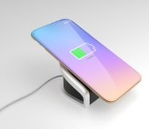
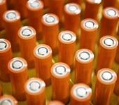

Trusted Solutions for Connectivity
Improve efficiency in R&D Design Validation, manufacturing monitoring, sourcing to retailing operations
Identify applicable regulations, standards and certification, testing for specific products and markets globally
Expertise in sustainability, energy efficiency and green attributes from design stage to end of product life-cycle

Slide 7
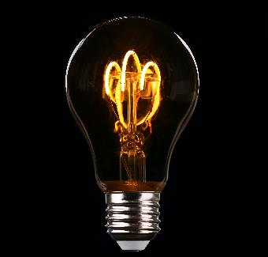



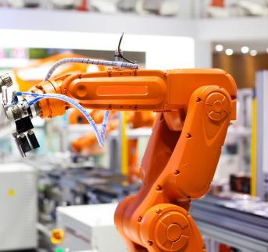
Areas We Can Help
ELECTRICAL &
ELECTRONICS
TECHNOLOGY
CONNECTIVITY
ENERGY SOLUTION
HEALTH CARE
MACHINERY &
COMPONENTS
Household & professional appliances
Home entertainment electronics
Consumer & professional lighting
Home and gardening tools
IT equipment & products
Smart electronics
Home automation
Mobile phone & tablet, 2-way radios
Software apps
Power supplies
Wireless charger
Battery and accumulators
Solar panel
Wind turbine
Home health care devices
Hospital medical devices
IoT connected medical devices
Microelectronics
Automation and robotic
Automotive electronics

Slide 8

Services We Offer
  TESTING & CERTIFICATION
    Product certifications (CB, GS, NRTL)
    EMC/RF – Electromagnetic Compatibility & Radio Frequency
    Wireless regulatory & conformance
    Chemical & materials – RoHS, REACH, Food contact, and California Prop 65)
    Functional safety
    Equipment used in potentially explosive atmospheres - ATEX and IECEx
    Energy efficiency (ErP, Energy Star)
    Alliance logo testing/certification (Bluetooth, Zigbee, WiFi)
    International Type Approval (ITA) (cover 180+ countries)
    Security evaluation of various IT products

Slide 9
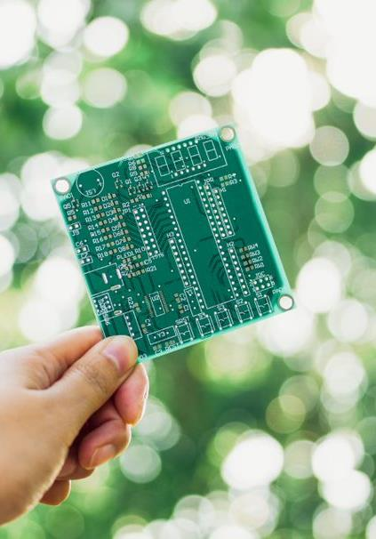
Services We Offer
  TOTAL SOLUTION
    R&D design validation
    Performance & reliability
    IoT eco-system
    Cybersecurity
    Software/apps validation
    Failure and damage analysis
    Sustainability (reduce, re-use, recycle)
    Retailer & e-commerce supply chain management
  INSPECTION & PRODUCTION MONITORING
    IPC – Initial Production Check
    DUPRO - During Production Check
    FRI - Final Random Check
    L/S – Loading/Supervision
    QAP - Quality Assurance Program for Manufacturers & Retailers
    QIP – Quality Improvement Program for Suppliers & Manufacturers
    Individual customer modules
    SQE – Supplier Quality Engineering

Slide 10
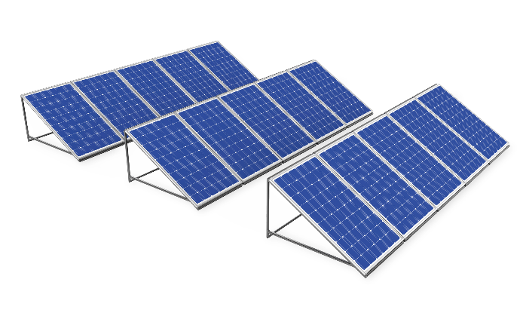


Services We Offer
  AUDIT
  Technical Factory Audit
  RBA (Responsible Business Alliance)
  Conflict Minerals
  JAC Audit (Telecommunication Industry )
  Environmental assessment and improvement
  Security assessment
  Anti-corruption
  TRAINING & QUALITY ENHANCEMENT
    Regulatory update
    Quality system certification
    Functional safety
    IT security
    Sustainability management

Slide 11
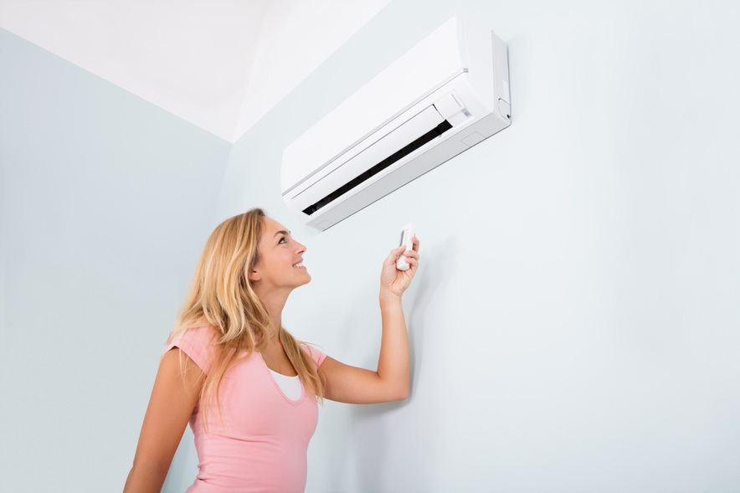

Trusted appliances are used in daily life
We test a large variety of appliances.
Small Appliances
Personal Care Products
Large Appliances
Comfort Products
Commercial Products

Slide 12


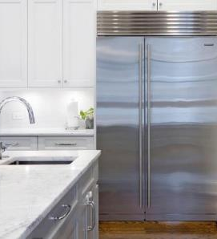

Customized Appliance Testing
Specialized testing for connected appliances
EMC Testing
Bluetooth
WiFi
FCC Compliance
Energy efficiency certification for your appliance
ENERGY STAR
NRCan
DoE
CEC

Slide 13
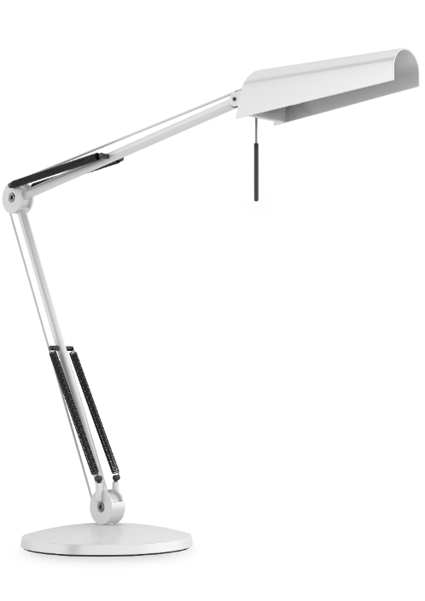
Bringing Light to Compliance
We cover a large variety of products.
Luminaires
Lamps
Portable Luminaries
LASER Equipment
Low Voltage Lighting Systems
Landscape Lighting
Horticultural Lighting
Photo Biometric Testing for Medical Devices
Lighting Controls
LED Equipment
LED Driver
Hazardous Location Luminaries
Self Ballasted Lamps & Lamp Adaptors
Electric Signs

Slide 14

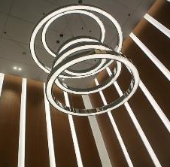

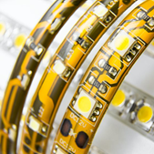
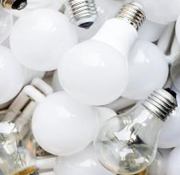

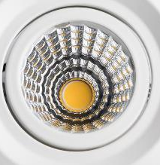
Full Range of Lighting Capabilities
Safety
UL 8750
UL 1598
UL 2108
UL 588
UL 1993
UL 8800
IEC 61437
IEC 60598
Performance
Ingress Protection (IEC 60529)
Environmental: UV, Salt, Spray, Temperature & Humidity
Mechanical: Shock & Vibration
In-Situ Temperature Measurement
Photobiological Safety (IEC 62471-1 & IEC/TR 62471-2)
FlickerNema 77
Photometry
LM – 79
LM – 80
LM – 66
LM – 65
LM – 82
LM – 84
EN 13031-1
EMC
FCC Part 15 & 18
ICES-003
ICES-005
EN 55015
EN 61547
EN 55022
EN 55024
Energy Star
Integral LED Campus
Luminaires
CFLS
Chemistry
RoHS
RoHS 2
CEC
RF
FCC 15C
RSS-247
EN 300328
EN 301893

Slide 15


Your DIY Partner
We offer services for a wide range of do-it-yourself, home improvement tools.
Power tools
Lawn and garden tools
Home improvement products
Outdoor heaters

Slide 16
Power Tools: Start to Finish
Chemistry Testing
Drop
Torque
Durability
Hardness
Dimension
Packaging Testing
Coating Thickness
Strength of Attachment
Compression and Tension
Corrosion and Accelerated weathering
  CA Prop 65
  Emissions: VOC testing for paints
  Restriction of Hazardous Substances (RoHS) for electric products
  Toxics in Packaging Cleating House (TPCH) for hazardous materials
  Federal Formaldehyde Requirements
  CA Toxics Reduction in Lighting Act
  Safety
  Battery
  Performance & Reliability
  Electromagnetic Compatibility (EMC)
  Product Benchmarking
Physical Testing
Electrical Testing

Slide 17
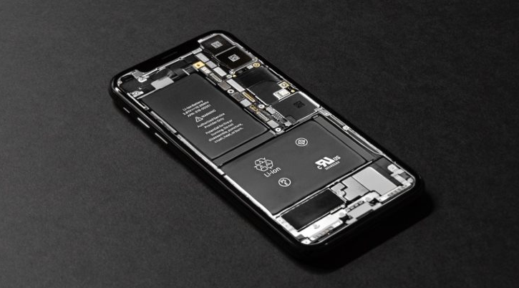
Batteries are everywhere
Battery Locations World-wide: USA, China, Germany & Taipei City.
We test and certify virtually every type of battery product including Lithium Ion, Nickel Alkaline, & Lead Acid.

Slide 18
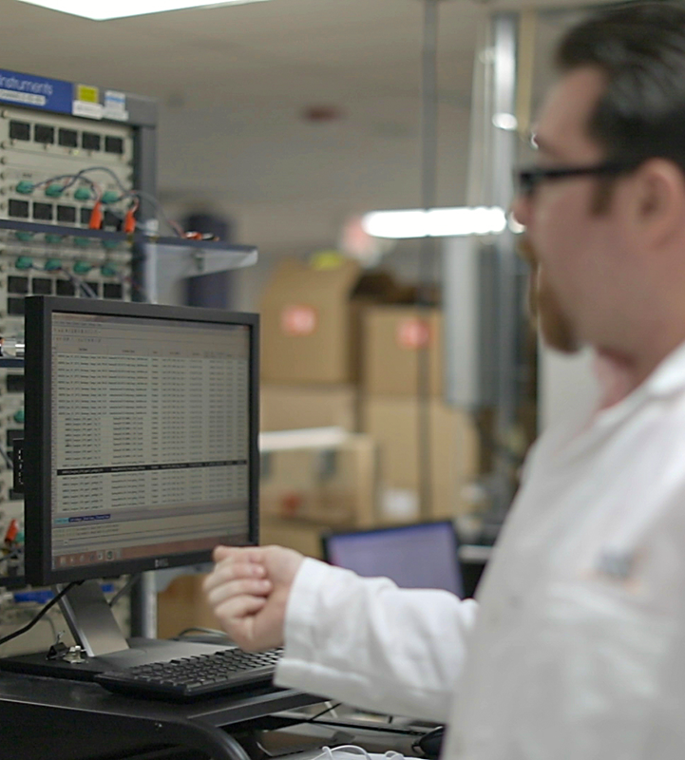

Battery Solutions:
Granting Power to the World
Over 40 Battery Specific Standards to ISO 17050
Over 25 Battery Specific Standards to IECEE CB Scheme
Testing to UN 38.3 - Transportation
Types of batteries and accessories we can test:
Cells, Powerpacks & Modules
Power bank
Chargers
Adapters

Slide 19
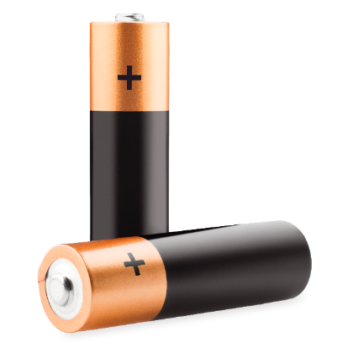
Battery Test Offerings
Life Cycle Testing
Abuse Testing
Performance Testing
Transportation Testing
Lithium Ion & Nickel Safety & Certification
Battery Charger Electrical Safety Testing
Custom and Customer Specific Testing

Slide 20

Solar
Safety Testing
IEC 62109-1, IEC 62109-2
IEC 62116 (EN 50178/IEC 62103)
IEC 62447-1
UL 1741 & CSA C22.2 No. 107.1-01
AS 4777-2:2015
EMC Testing: IEC 61000 SERIES
Efficiency Testing
IEC 61683
EN50530
Climate Testing
IEC 61683
EN50530

Slide 21

Medical Devices – keeping the world healthy
We offer services for a wide range of electrical medical devices
Patient Monitors & Accessories
Wearable Devices
Home Healthcare
In Vitro Diagnostic Devices
HF Surgical & Accessories
Infusion Pumps
Telehealth Products
Hospital Beds, Nurse Carts, & Furnishings
Incubators
Physical Therapy Equipment
Imaging Equipment

Slide 22

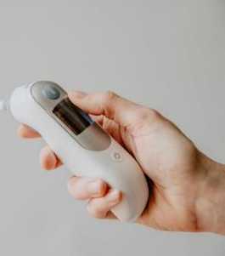
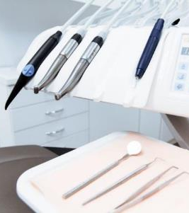
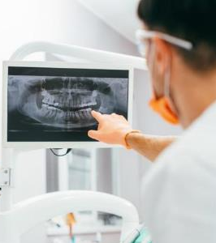
Electro-Medical Devices
Key Services
Customizable Testing
Water and Dust Ingress Testing
Power Supply and Component Testing
Drop, Impact and Mechanical Shock Testing
Vibration Testing
Environmental Testing
Cybersecurity Testing

Slide 23
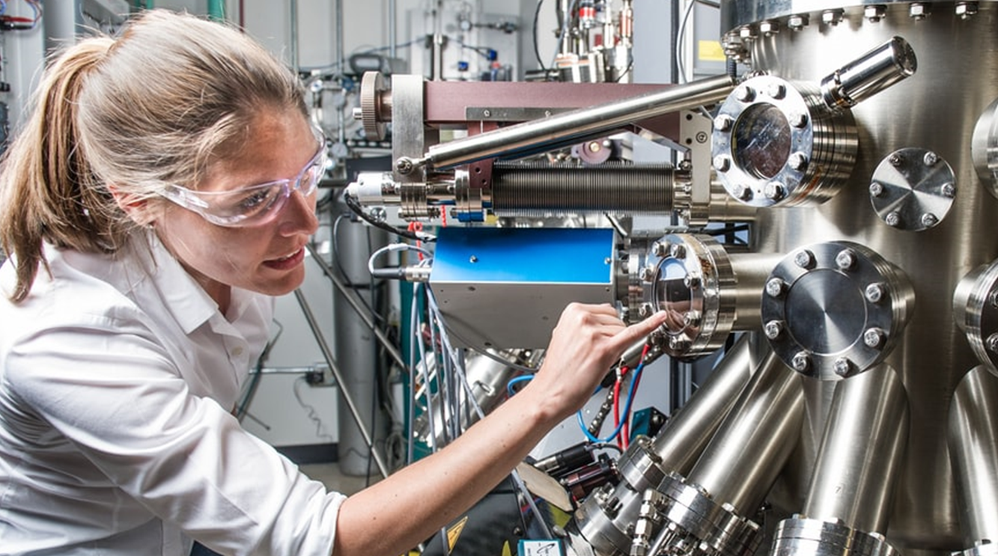
Machineries – Safety Testing

Slide 24



Capabilities
CE Directive Marking
RoHS, ENEC, HAR
SGS GS Mark, Germany
SGS Fimko Mark & Nordic Certification
SGS CEBEC
Russia GOST-R Mark & Eurasian Economic Community EAC mark
PoHS Norway
SGS Bauart Gepruft Mark, Germany
SGS NRTL
FCC USA
INMETRO Brazil
CCC China
CHINA RoHS
BSMI Mark, Taiwan
Korea RoHS
eK Mark, Korea
MIC Mark, Korea

Slide 25
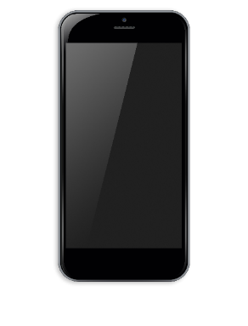
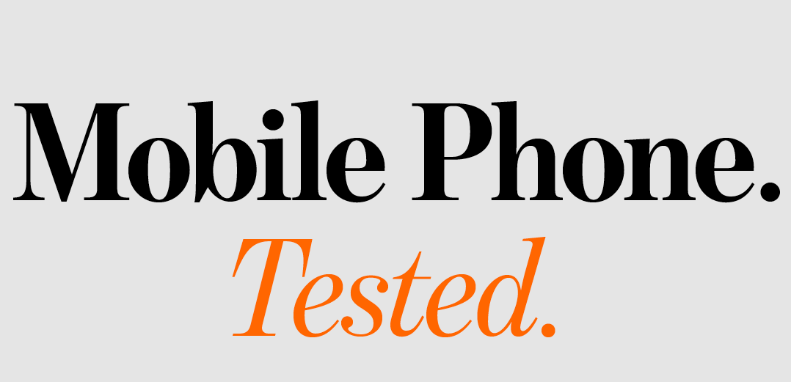
Why Choose Us?
We’re the world’s leading inspection, verification, testing and certification company
We offer a wide range of services for all varieties of Electrical and Electronic products
We have a global network of testing labs (ISO 17025 accredited) in Europe, Asia & the USA
We have technical experts with experience in international markets. We offer consultancy services on problem solving by chemists, supply chain experts and skilled engineers
We have added-value services to your suppliers (e.g. supplier training, regulatory updates)

Slide 26

Thank you!
Do you have any questions?
naeem.minhas@sgs.com
asim.hussain@sgs.com;
qurat.ulain@sgs.com
© SGS Group Management SA – 2021 – All Rights Reserved – SGS is a registered trademark of SGS Group Management SA

