Slide 1

Connectivity & Products (C&P)
Working across industries and geographics
Inspection
Verification
Testing
Certification
DATE: AUGUST 23, 2023, I NAME: QAISER IQBAL C& P

Slide 2

SGS
OUR HISTORY
Founded in 1878 as a grain inspection company
Expanded beyond agriculture in early and mid 20th century to:
Minerals
Oil, gas and chemicals
Consumer goods
Industrial sector
Listed in 1981
Growth and diversification continued throughout last half of the century
Current structure of ten business units initiated in 2001

Slide 3





Latest About SGS
SGS is the world's leading inspection, verification, testing and certification company.
Four divisions - Connectivity & Products, Health & Nutrition, Industries & Environment and Natural Resources) and strategic unit (Knowledge)
Specializing in helping businesses large and small
Industry leader with reputation for integrity
Consistency in audits
Flexibility to meet unique needs
Most recognized registration worldwide
Nº1
World leader
89 000
Employees
2 600
Offices and laboratories
11
Global industries
Global Service
Local Expertise
Notes:
With over 89 000 employees strategically located around the world, SGS works across 11 industries and throughout the supply chains providing specialized business solutions that improve quality, safety, productivity and reduce risk. Our network of over 2 600 offices and laboratories help customers navigate an increasingly regulated world by offering local expertise on a global scale.
Today, we are:
The world’s leading inspection, verification, testing and certification company
The leading provider of competitive advantage, driving sustainability and delivering trust
The globally recognised benchmark for quality and integrity
We continue to push ourselves to deliver innovative services and solutions that help our customers move their businesses forward
AND we aim to remain in this position.

Slide 4

SGS MEANS
SUSTAINABILITY- C&P
Customer challenges:
Reducing quality, social and environmental risks
Eliminating defects at early stages of production
Ensuring quality , performance and compliance with local and international requirements
Achieving a faster time to market, avoiding regulatory and non-compliance bottlenecks
Managing social and environmental impacts of products throughout lifecycle
Substantiating product claims to maintain a competitive edge
Replace logo with gray or white, whichever is more visible above the image.

Slide 5
SGS MEANS
SUSTAINABILITY- C&P
For example:
Product recalls
Demonstrating sustainability
Our key services:
Product testing, certification, verification, inspection and assessment
Supplier audits and consulting services to the Electrical & Electronics, Textiles, Footwear, Hardlines and Food sectors
Replace logo with gray or white, whichever is more visible above the image.

Slide 6
SGS MEANS COMPLIANCE
TRADE FACILITATION SERVICES
Customer challenges:
Facilitate Trade, support good governance and promote sustainable development by combating counterfeits, improving import/export processing, assessing and improving visibility and accountability
For example
Product Conformity Programs
Our key services:
Revenue enhancement:
Import verification and destination inspection
Conformity assessment
Trade compliance and security
Notes:
Digitization & Traceability
Source : https://www.supplychainbrain.com
Nearshoring
Source : https://www.connects.world / https://www.fashionatingworld.com

Slide 7
SGS MEANS COMPLIANCE
TRADE FACILITATION SERVICES
Trade efficiency:
ValiTrade and TradeNet
Cargo scanning
Transit Monitoring
Aid efficiency:
Aid monitoring
NGO benchmarking
Forestry monitoring
Notes:
Digitization & Traceability
Source : https://www.supplychainbrain.com
Nearshoring
Source : https://www.connects.world / https://www.fashionatingworld.com

Slide 8
SGS MEANS COMPLIANCE
TRADE FACILITATION SERVICES
Case study
Product Conformity
Assessment Programme:
Ensures imported products conform with applicable national standards and regulations- prior to their shipment
Demonstrates compliance regulatory requirements and helps combat counterfeit.
Active programmes around the world including:
- Algeria
Kenya
Saudi Arabia
Iran
Russia(GOST)
Nigeria
Indonesia
Notes:
Digitization & Traceability
Source : https://www.supplychainbrain.com
Nearshoring
Source : https://www.connects.world / https://www.fashionatingworld.com

Slide 9

SGS MEANS INSPECTION
AUTOMOTIVE SERVICES
Customer challenges:
Maximising remarketing value and speed to market
Monitoring quality of vehicles from factory to clients
For example: abc cab
Our key services:
Vehicle Safety and Emission inspection
Road Safety Enforcement Vehicle Registration
Driver Lecensing
Traffic Technology Testing and Verification
Vehicle inspection and Verification
Damage Prevention Inspection
Remarketing inspection
Mystery shopping and auditing

Slide 10
SGS has extensive experience in a wide variety of food contact materials and articles to meet international regulations and standards
Food Contact material and articles
Bakeware, cake pans, coffee makers, cookware, plastic containers, saucepans, stir-fry cookware, stock pots, tea kettles, woks
Cutlery, flatware, hollowware, kitchen utensils
Ceramics, glassware plates and tableware
Small kitchen appliances
Notes:
Digitization & Traceability
Source : https://www.supplychainbrain.com
Nearshoring
Source : https://www.connects.world / https://www.fashionatingworld.com

Slide 11
Why choose SGS?
SGS helps you to enhance the deign, safety and quality of food contact materials and articles for global markets.
Armed with extensive expertise and quality technical support, SGS offers complete testing and certification solutions,consultany for technical and regulatory requirements, as well as audits and inspections for a comprehensive range of food contact materials and articles
SGS aim to ensure your products are of sufficient high quality to last in a quality driven market
SGS’s laboratories are accredited to test food contact materials and products in accordance with regulatory standards
About 30 labs worldwide providing FCM testing
Notes:
Digitization & Traceability
Source : https://www.supplychainbrain.com
Nearshoring
Source : https://www.connects.world / https://www.fashionatingworld.com

Slide 12

What are the challenges for food contact products?
Food contact materials must not transfer their constituents into a foodstuff in unacceptable quantities that could affect the health of consumers, nor influence the quality of food such as:
Changing food composition in an unacceptable way
Adversely affecting the taste and smell characteristic of food
Replace logo with gray or white, whichever is more visible above the image.

Slide 13
What are the challenges for food contact products?
Consumers expect products they purchase to be safe and to meet chemical , performance/ safety and construction standards
They want to be assured that:
Substances used are authenticated.
Migrated substances are within acceptable level
Replace logo with gray or white, whichever is more visible above the image.

Slide 14
Pan handles are reliable
Cups are microwave safe, as claimed
Plates are dishwasher safe, as claimed
Replace logo with gray or white, whichever is more visible above the image.

Slide 15
F
C
M
Food Contact material and articles | Citations
1- Food contact materials and articles | Council of Europe Resolution CM/Res (2020)9’ safety and Quality of Materials and Articles for Contact with Food
2- Coatings | Council of Europe Resolution ResAP(2004) 1
3- Cork stoppers and other cork materials | Council of Europe Resolution ResAP(2004) 2
4- Ion exchange and adsorbent resins resins | Council of Europe Resolution ResAP(2004) 3
5- Rubber | Council of Europe Resolution ResAP(2004) 4
6- Inks | Council of Europe Resolution ResAP(2005) 2

Slide 16
F
C
M
Food Contact material and articles | Citations
7- Silicones | Council of Europe Resolution ResAP(2004) 5
8- Metals and Alloys | EDQM/ Council of Europe Resolution CM/ResAP(2019) 9, migration of 21 metals
9- Paper and Board | EDQM/Council of Europe, First Edition, May 2021
Note: EDQM: European Directorate for the Quality of Medicines & Healthcare

Slide 17

Connectivity & Products (Trade Facilitation Services and Government Mandate)
SGS Pakistan is facilitating following countries in food and non-food commodities for the Certificate of Conformity-CoC
A document that is mandatory for customs clearance including Kenya, Uganda, Tanzania, Zanzibar, Morocco, Saudi Arabia, Burundi, Ivory Coast, Algeria, Egypt, Cameroon, South Sudan, Qatar, Ethiopia, Kuwait, Algeria, Mongolia, Gabon and Gulf
you may let us know SGS Pakistan in case of any assistance
Replace logo with gray or white, whichever is more visible above the image.

Slide 18

New Certification Mark Enhances Trust in Food Contact Products
SGS launches the SGS Food Contact Product Certification Mark to help manufacturers and suppliers demonstrate the compliance, safety and performance of their products.

Slide 19

Food contact materials (FCM) must not endanger human health or alter the food or drink they are in contact with through chemical substance relief. Consumers and regulatory authorities are now looking for independent verification that products meet market requirements for safety and performance.
Replace logo with gray or white, whichever is more visible above the image.

Slide 20
The SGS Food Contact Product Certification Mark covers both mandatory safety requirements and voluntary performance parameters. It improves traceability and builds consumer confidence while simplifying market access and delivering competitive advantage.
Replace logo with gray or white, whichever is more visible above the image.

Slide 21
Utilizing SGS global network of state-of-the-art testing facilities, SGS Teams provide comprehensive testing and certification services for the full range of FCM product categories, including:
We cover products made from:
Plastic, rubber and silicone
Metals and alloys
Vitreous (glass, ceramic, enamel)
Paper and paperboard
Preparation wear - bibs, napkins, etc.
Preparation utensils - bake- or cookware, etc.
Serving utensils - drink- and tableware
Serving implements - cutlery or chopsticks, etc.
Food containers - lunchboxes or foils, etc.
Notes:
Digitization & Traceability
Source : https://www.supplychainbrain.com
Nearshoring
Source : https://www.connects.world / https://www.fashionatingworld.com

Slide 22
Using SGS experience of critical parameters and target market requirements, SGS Teams define the testing scope to ensure it meets the requirements of the market and manufacturer/supplier.
Certification is offered as either 'Food Safe' or 'Food Safe and Performance' and is a clear indication that a product complies with all relevant standards required to succeed in competitive, regulated markets like USA, EU, UK, Switzerland and China and others
Replace logo with gray or white, whichever is more visible above the image.

Slide 23

Certified products can display the SGS Food Contact Product Certification Mark, which includes:
Evidence of independent certification by a trusted service provider
Information on the criteria against which the product was assessed (safety/performance)
QR code linked to the ProCert client database
Sample
Sample

Slide 24
Food Contact Materials Testing
At a time when regulatory authorities and consumers are demanding independent verification that products are safe and will perform effectively, the SGS Food Contact Product Certification Mark shows manufacturers/suppliers have gone beyond basic compliance, building trust in their products and gaining competitive advantage in global markets.
. At the beginning of future projects, team leaders can use the evaluations to learn what not to do, thereby reversing any damaging trends
Notes:
Digitization & Traceability
Source : https://www.supplychainbrain.com
Nearshoring
Source : https://www.connects.world / https://www.fashionatingworld.com

Slide 25

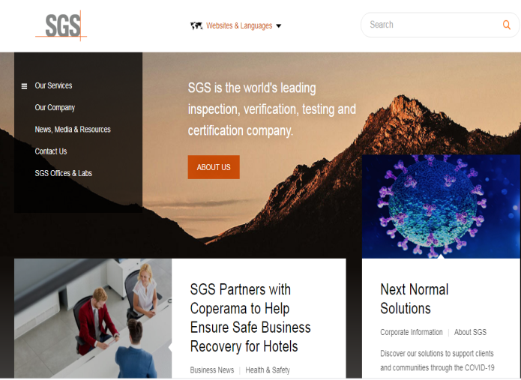
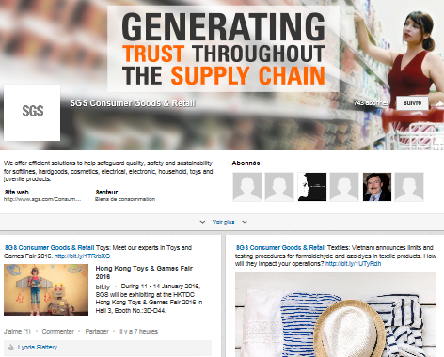
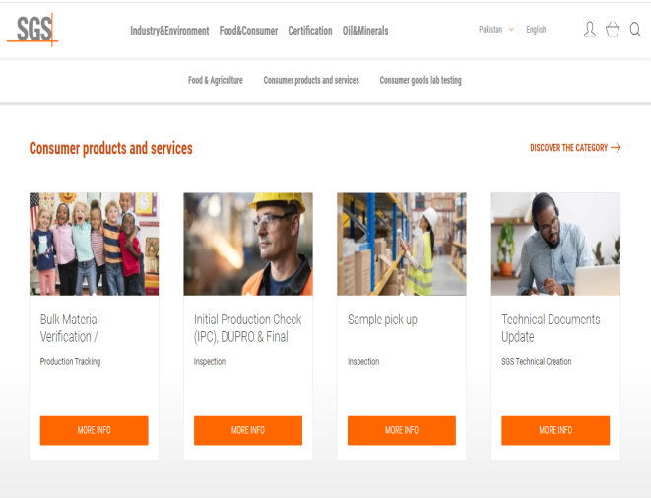

Connectivity AND Product
CONNECT WITH US
VISIT SGS WEBSITE WWW.SGS.COM
KEEP UP-TO-DATE
Online Services.sgs.com
VISIT SGS’S LINKEDIN
PAGE TODAY AND FOLLOW US NOW!
www.sgs.com/linkedinconsumer
© SGS Group Management SA – 2020 – All Rights Reserved – SGS is a registered trademark of SGS Group Management SA

Slide 26

Questions?
© SGS Group Management SA – 2020 – All Rights Reserved – SGS is a registered trademark of SGS Group Management SA

Slide 27

Contact us
Contact us today:
www.sgs.com
Subscribe to our news and resources at
www.sgs.com/subscribe
© SGS Société Générale de Surveillance SA – 2021 – All rights reserved - SGS is a registered trademark of SGS Société Générale de Surveillance SA

