Slide 1
2 Days Awareness Session Product Conformity Assessment

Slide 2
Notes:
Emphasise now the skills - demonstrated by doing.
ENABLING OBJECTIVES – KNOWLEDGE & SKILLS
In order for students to achieve the overall learning objectives, they will need to acquire and develop specific knowledge and skills. These can be considered as steps to the achievement of learning objectives.
Emphasise that this course uses a well designed structure with a mix of tutor driven discussions with slides, Exercises, Workshops and homework to enable to perform a practical audit for an environmental system.

Slide 3
About the Trainer
Conducted more than 900 Man hours Audits of Management Systems (Quality, Safety, Env, security)
Conducted more than 1400 man hours training on Product & System management standards.
Corporate Freelance Incident Investigator for multiple MNCs
Risk Evaluator
Product Conformity
Traceability Mapper (Specialised for Recycled & Organic) for Multiple Brands
Product LCA coordinator (Start to Sale Or Farm to Athlete Concept)
Master in Philosophy: Environment Health Safety
Lead Auditor QMS / EMS/ OHSMS
Certified Labour Laws Professional
Carbon Neutrality Verifier PAN Pakistan
Notes:
3

Slide 4
Learning Objectives
Skill Development Course Not just Knowledge
to establish Gaps or barriers in international trading
Of yours's Choice
How to sell product by complying with specific regional requirements
Complete process of Conformity Assessment.
Regional & International requirements/ Directives
Notes:
Emphasise now the skills - demonstrated by doing.
ENABLING OBJECTIVES – KNOWLEDGE & SKILLS
In order for students to achieve the overall learning objectives, they will need to acquire and develop specific knowledge and skills. These can be considered as steps to the achievement of learning objectives.
Emphasise that this course uses a well designed structure with a mix of tutor driven discussions with slides, Exercises, Workshops and homework to enable to perform a practical audit for an environmental system.

Slide 5
- Accreditation & Certification Process
Notes:
There can be a number of questions by the students in this chapter, and so the tutor must keep about 10 to 15 minutes ‘spare’ time while delivering the chapter. This time should be managed within the total time scheduled for the chapter.

Slide 6
Accreditation/Certification Process
Accreditation Board Function
Accreditation Board
(e.g. ANAB, UKAS,NABCB…)
ISO /IEC 17021 and IAF Guidelines
Certification/Registration Body (CB)
(e.g. Bureau Veritas Certification)
ISO 45001 or any one
Organization to be certified
(i.e. Client)
Notes:
Demonstrates the hierarchy of authority and guiding documentation.
IAF is International Accreditation Forum.
Accreditation bodies verify that certification bodies conduct their activities according to pre-established guidelines.
Certification bodies verify that organizations meet the requirements of standards.

Slide 7
Certification Process
Accreditation/Certification Process
Client/
Organisation
Application
CB
Contract Review:
Scope
Time-scale
Audit team
Stage 1 Audit
Stage 2 Audit
Recertification
Certification
Surveillance
Ref :ISO/IEC 17021
Notes:
Gives an overview of the certification cycle.
Cover each phase briefly as an introduction. The stage one audit verifies the content of the contract including scope and time needed for stage 2. Details are provided in the remainder of the chapter.
A need for a review of the contract may be necessary after the Stage 1 & before Stage 2 audits depending on the findings of the Stage 1 audit such as the Manpower (ref : Clause 7.1.2 of ISO 9001), scope, number of sites which may differ from the original contract.
Before Recertification also, The Contract will have to be reviewed again and revised in case of changes to Manpower, scope, Number of sites etc..
The tutor may ask delegates – under what circumstances can the recertification audit contract be different than the certification contract? The answers can be – change in process, site additions, change in number of persons, etc.

Slide 8
Stage 1 – “Readiness audit”
Accreditation/Certification Process
Recommended to be done on site.
Audit of documentation
Evaluation of location / site specific conditions
Review of Key performances parameters
Validation of scope.
Collection of information regarding statutory & regulatory requirements and their
compliance
Review of allocation of resources for stage 2 audit, agree with client and plan for
Stage 2.
Evaluation of Internal audits & Management reviews
Assess the overall readiness for Stage 2 audit.
Report the findings including areas of concern to the Client /Auditee
Ref :ISO/IEC 17021
Notes:
Clause 9.2.3.1 of ISO/IEC 17021 is narrated here.
Next 2 slides present key concepts of stage 1 audit. At least part of the Stage 1 shall be conducted at the organization’s “site”
Note that Workshop 1 was a documentation Audit.
The purpose of stage 1 audit is to gather enough information without going into to much detail.

Slide 9
Accreditation/Certification Process
Stage 2 “Implementation” Audit
Conformity to all requirements of the Audit Criteria
Performance against objectives.
Performance against legal compliance
Operational control of clients’ processes
Internal auditing and management review results, actions and their effectiveness at locations.
Management’s responsibility for their policies
Ref :ISO/IEC 17021

Slide 10
Surveillance audits
Accreditation/Certification Process
Conducted at least once per year (some at 6 months) on site.
Covers all functions/processes over a 3 year period subsequent to certification / Re certification audits
Audit plan based upon results of previous audits & importance & status of processes.
Internal audits may be taken into account
Assess organisations’ continued conformance to the certified standard requirements
What shall be checked during surveillance audits ….?
Ref :ISO/IEC 17021
Notes:
Covers the surveillance audit and key considerations.
The tutor to encourage discussions amongst delegates on “What must be covered during surveillance audits..? (As per 9.3.2.1 of ISO/IEC 17021, internal audits, Management Reviews Actions taken on Previous NCs, Customer Complaints, Effectivenss of System, Continual Improvement, use of Marks/ Logo etc are to be covered)

Slide 11
Introduction
What is Conformity Assessment
Overview of Conformity Assessment
ISO/CASCO
Objects of Conformity Assessment
European & Gulf Conformity Assessment Programs / Directives
Conformity Assessment Process
European Conformity Assessment Program CE Marking
Trademarks, Copyrights, Patents
ISO 17001:2015 Review

Slide 12
Introduction to
conformity assessment and
ISO/CASCO

Slide 13
What is conformity assessment
Is all the activities we complete to determine if a product or service meets specific requirements (usually contained in a standard)
definition
the demonstration that specified requirements relating to a product, process, system, person or body are fulfilled.

Slide 14
Objects of Conformity Assessment
Products
Services
Processes
Management systems
Personnel.
Notes:
14

Slide 15
Conformity assessment activities
Testing
determination of one or more characteristics of an object of conformity assessment
Certification
third party assurance that: product (services), process, personnel, organization or management system conforms to specific requirements
Inspection
Examination of a product design, product, process or installation and
determination of its conformity with specific requirements or, on the basis of
professional judgement, with general requirements.
Supplier's declaration of conformity
first-party attestation
Accreditation
third-party attestation related to a conformity assessment body conveying formal demonstration of its competence
Mutual recognition & Peer assessment
Arrangement whereby more than two parties recognize or accept one another’s conformity assessment results
Assessment of a body against specified requirements by representatives of other bodies in, or candidates for, an agreement

Slide 16
Conformity assessment claims
Test done by: 1st party (the manufacturer, service provider) | Attestati SDoC (Self Declar of Conform
2nd party (the purchaser, the client) | Contract
3rd party - independent (certification body, laboratory, inspection body...)
on type
Object
ation ity)
+
Requirements
Certificate
3rd party bodies can be accredited.
Accreditation bodies are assessed by their peers

Slide 17
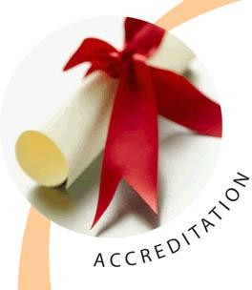
Conformity assessment in action
How do you determine if a product meets a technical requirement ?
Action
Conformity assessment activity
Design the TV
Test design in laboratory
TV set meets the technical
specification or standard
Test TV samples from
production line
Manufacture the TV
Quality management system (QMS) in place in the factory (certification of QMS)
TV sets in storage
Inspect samples of the TV sets prior to distribution to make sure no damage
Distribute the TV to shops
Take samples from the shop to ensure it meets specification (Market Surveillance) the regulator may do this

Slide 18
What is ISO/CASCO?
ISO committee that works on issues relating to conformity assessment
It publishes standards for the operation of conformity assessment bodies and develops policies related to conformity assessment (mostly together with IEC)
126 members of ISO participate in CASCO and 22 external organizations are in liaison

Slide 19
CASCO structure

Slide 20
ISO/CASCO Toolbox
conformity assessment bodies (laboratories, certification bodies and inspection bodies)
The ISO/CASCO
Toolbox is the set of conformity assessment standard developed by ISO CASCO for the operation of
accreditation bodies
for peer evaluation and other associated activities
ISO/CASCO has over 35 published standards and guides

Slide 21
Conformity assessment bodies and CASCO standards
Certification bodies
use ISO/IEC 17021 –
requirements for certification of Management Systems, ISO/IEC 17065 for products
ISO/IEC 17024 for persons
Inspection bodies
use ISO/IEC 17020 –
requirements for inspection of various items etc.
Laboratories
use ISO/IEC 17025
– requirements for
competence of labs

Slide 22
Some CASCO standards –
An short overview

Slide 23
Contents
ISO/IEC 17025 Testing and calibration laboratories
ISO/IEC 17020 Inspection bodies
ISO/IEC 17065 Product certification (for products, processes and services)
ISO/IEC 17021 Management system certification
ISO/IEC 17024 Personnel certification
ISO/IEC 17000 Vocabulary and general principles
CASCO toolbox (over 35 standards and guides)

Slide 24
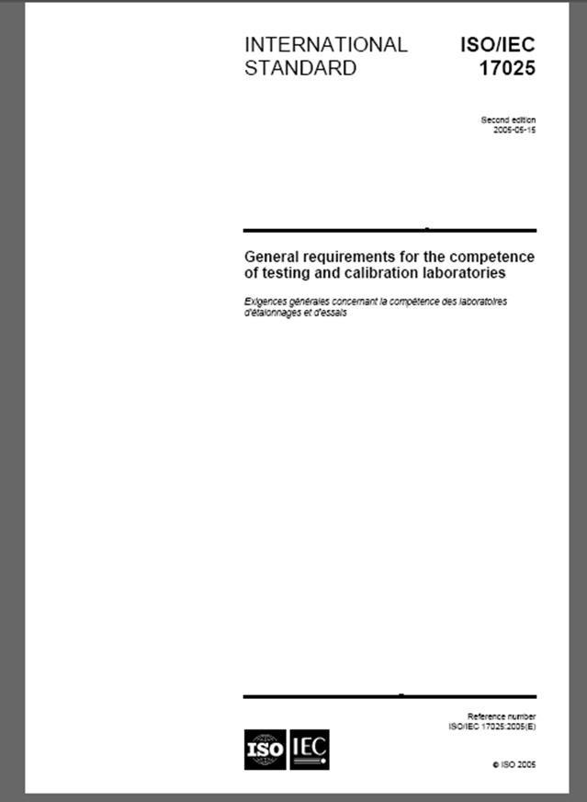
ISO/IEC 17025: Requirements Testing and calibration laboratories
Basic requirements that a laboratory should comply with to demonstrate it is competent to perform specified tests and calibrations:
Management system requirements are common to all laboratories irrespective of the technical work they perform.
Technical requirements have to be applied according to the specific field of work and require the laboratory to apply additional requirements specific to the field.
This aspect of additional requirements is recognized in Annex B (informative) and contains “Guidelines for establishing applications for specific fields”.

Slide 25
ISO/IEC 17025: Requirements Testing and calibration laboratories
The scope for which the laboratory does testing needs to be clearly specified and stated.
Usually the scope is supported by listing the specific test methods the laboratory uses in case of testing and specific measurements and associated uncertainty in the case of calibration laboratories.
This detailed definition of the scope allows the laboratory to identify competent people to do the work within their scope of activity.
It also allows for the customers of the laboratory to identify a suitable laboratory for their purposes and have confidence in the tests and measurements made by the laboratory.
When a laboratory is accredited to ISO/IEC 17025 its compliance is not only assessed to the generic standard ISO/IEC 17025 but also to any field specific requirements and to the laboratories’ competence to perform the specific test methods.

Slide 26
ISO/IEC 17020: Requirements Inspection bodies
Inspection :
Examination of a product design, product, process or installation and determination of its conformity with specific requirements or, on the basis of professional judgment, with general requirements (e.g. inspection of fire extinguishers, lifts, restaurants, road vehicles (annually) etc).
Provides objective evidence that an inspected item meets the specified needs of the customer (purchaser, manufacturer regulator).
Heavily relies on professional judgment of the inspector whose competence is crucial to the success of this activity.

Slide 27
ISO/IEC 17020: Requirements Inspection bodies
Inspection can be used as a risk management tool:
Many plants and installations use inspection to ensure that equipment and plant facilities continue to operate safely and correctly.
Inspections are usually performed on site and allow for the clients to be informed immediately.
Inspections of items before shipping or confirmation with the order can prevent shipment of the wrong materials, this is very important in building material shipments.

Slide 28
Requirements Certification bodies
3 main types of certification activities:
Product certification, ISO/IEC 17065:2012 (products, processes and services certified)
Management system certification,
ISO/IEC 17021-1:2015 (ISO 9001
certified company)
Personnel certification, ISO/IEC 17024:2012 (Welder/Food safety certified)

Slide 29
Requirements for product, process and service certification (ISO/IEC 17065)
The overall aim of certifying products, processes or services is to give confidence to all interested parties that a product, process or service fulfills specified requirements.
The value of certification is the degree of confidence and trust that is established by an impartial and competent demonstration of fulfillment of specified requirements by a third-party.

Slide 30
Product, process and service certification (ISO/IEC 17065)
4 basic drivers for product, process and service
certification:
provide consumers (users) of products with sufficient information to allow them to make informed decisions on products and services;
assist the suppliers of certified products to achieve market acceptance. If the product has a recognizable mark on it consumers may be more willing to make the purchase;
product certification plays a role in regulated products
(subject to technical regulations);
assists manufactures in selecting the components for their own products;
retailers have confidence in the products they are selling.

Slide 31
Product, process and service certification (ISO/IEC 17065)
Product certification may consist of:
initial product testing with assessment of the quality management system;
followed up by testing of samples from factory and/or the open market;
initial testing and surveillance testing;
type testing : testing of a sample product.
The type of product certification scheme chosen:
will depend on the level of risk to the consumer as well as other factors;
for a very low risk product you may have a once-off type test;
for a high risk product you may have a scheme which has type testing, requires an ISO 9001 management system in place with regular product testing from the factory and also products taken from the outlets for testing.
ISO/IEC 17065
Conformity assessment - Requirements for bodies certifying products, processes and services
can be used in combination with a number of related product standards and guides to demonstrate that a product complies with specified criteria.

Slide 32
Requirement for bodies providing certification of persons (ISO/IEC 17024)
Certification of persons has the objective of recognizing the competence of individuals to perform specific tasks.
It recognizes that competence is not solely related to qualification but is based on the an individuals ability to apply knowledge and skills to achieve intended results.
A person can be well qualified but be incompetent. There are good doctors and not so good doctors and bad doctors.
Competence is not based on qualification alone.
ISO/IEC 17024:2012
Conformity assessment
- General
requirements for bodies operating certification of persons

Slide 33
Objects of Conformity Assessment
(Products)
Suppliers can use several ways to indicate certain characteristics of their products, including:
• pictograms – often used to give advice to users, e.g. how to wash cloths;
• logos and trademarks with a certain image related to it, e.g. Coca Cola, Nike, Rolex;
• Self-declaration of Conformity providing statements about, for instance, the product’s quality;
• marks of conformity issued by third parties, e.g., NF (France), SNI (Indonesia).
The latter is product certification. Product certification is primarily a commercial instrument for enterprises: the choice of mark on the product can stimulate its market acceptance. Due to the expenses of testing and certification the choice of whether to certify a product or not is a commercial decision. From a commercial viewpoint, a product certificate does not necessarily mean much. In many cases, it only increases the options when making an offer. Whether this leads to a real order is dependent on, amongst other factors, the price, the delivery time and the quality perception (what the supplier offers and/or what surpasses what is expected, for example delivery to special locations, gift packaging, spread of payment, etc.). The latter factors enable an organization to distinguish itself from competitors. For reputable companies, the added value of a certificate is less important than for relatively unknown companies, who need it as a "flag to wave”. As a consequence, the added value of a certificate on a well-known product is less than for an unknown product that can use the "backup support" that a certificate can usefully provide for entering the market. Some products, e.g. medical devices such as artificial heart valves, are subject to specific laws, like the European “New Approach” Directive on Medical Devices, resulting in de facto mandatory certification.
Notes:
33

Slide 34
Objects of Conformity Assessment
(Products)
Example: UL mark Product certification can relate to quality aspects, but also to safety aspects, environmental issues or to fair production circumstances. An example is the UL 8 mark issued by the American Underwriters Laboratories Inc. The UL Mark on a product means that UL has tested and evaluated representative samples of that product and has determined that they meet UL's requirements. Under a variety of their programmed, products are periodically checked by UL at the manufacturing facility to make sure they continue to meet UL requirements. These requirements are in fact the basic attributes to ensure safety and/or performance of the products
Notes:
34

Slide 35
Objects of Conformity Assessment
(Services)
In contrast to products, services are often less tangible. Nevertheless, conformity assessment applies here as well. McDonald’s, for example, has standardized its services to a large extent and has a system in place to make sure that all over the world their outlets meet the requirements the company has set for its services. Third party assessment in the form of certification is growing in service sectors as well, especially in France. For instance in the area of tourist services, the French certification activities include hotels, camping sites, restaurants, tourist offices, renting cars, congresses. Quality areas include information and communication, 10 attitude of personnel, competence of personnel, atmosphere and comfort of places, equipment used, and safety (Barthet, 2005).
Notes:
35

Slide 36
Objects of Conformity Assessment
(Processes)
In many cases, the way a process is executed is of crucial importance for the quality of the product it creates. In painting a car, for instance, not only the color of the paint but also a dust-free environment is of crucial importance. To enable a reliable and reproducible quality in such a case, an organization may choose to develop a detailed process description which can be used as a benchmark for this and similar production processes. In case of assessment by an independent third party, process certification may apply. Examples of process certification can be found in the food industry where, for example, hormones or animal living space cannot be detected in the final product (De Graaff, 1995). Another example of process standardization and related certification concerns the process of developing software, based on the CMM (Capability Maturity Model) standard. This standard was developed by the Software Engineering Institute, USA, for huge software development projects. The standard distinguishes between five levels of ‘maturity’. The ranking is based on the company’s standardization of processes in certain subject areas (Humphrey, 1989). Only a few software companies, most of these in India, have managed to get a certificate demonstrating that they have achieved the highest CMM levels, 4 and 5.
Notes:
36

Slide 37
Objects of Conformity Assessment
(Management systems)
A management system is a system to establish policy and objectives and to achieve those objectives (ISO 9000:2005). Examples of management systems include quality management systems, occupational health and safety management systems, and environmental management systems. Two other modules address management systems including conformity assessment: the case studies on, respectively, ‘Quality Management Methods and ISO 9000 Quality System Certification’ and ‘Implementation of the ISO 14000 Environmental Management System’. In this module we will just pay some attention to quality management systems. The best-known standard for management systems is ISO 9001:2000. At the end of 2005, the worldwide total of certificates to the ISO 9001:2000 quality management systems standard was 776 608. Certificates had been issued in 154 countries (ISO, 2006).
Notes:
37

Slide 38
Objects of Conformity Assessment
(People)
The rapid advances in technological innovation and the growing specialization of personnel have led to the development of certification schemes for professional human activities. Certification of personnel has become important as a means of demonstrating professional ability. This is increasingly significant in the light of today's difficult global job market, where a job is no longer considered a 'job for life'. Certification of persons provides a relatively simple means by which job capability for instance for ‘pilot’ or ‘welder’ can be assessed and recognized (Irving, 2001). The certification scheme defines the profile of education, knowledge, experience and responsibility required for a specific job, and provides a professional assessment procedure. Certification is concerned with current competence rather than considering the historical attainment of a diploma as the dominant feature, because periodic renewal is required. At present, more and more people have to demonstrate an appropriate level of competence in knowledge and its application. To employ competent personnel, manufacturers should ensure e.g. that engineers, designers and technicians have demonstrated the required and relevant level of competence
The European Directives and standards for welding require people with welding or welding related responsibilities to be able to demonstrate that they are competent to carry out these responsibilities (EN 719 ‘Welding Coordination - Tasks and Responsibilities’) (Irving, 2001).
• Malaysia developed a certification scheme for quality system consultants (Aziz Mat, 1998). 13
• In the USA, a system of (compulsory) certification for food safety managers is in place (Almanza and Nesmith, 2004).
Notes:
38

Slide 39
Conformity Assessment & International Trade
Mutual Recognition Agreements (MRAs)
For many companies, the market is the world market. Therefore, it would cost them a lot of money if they had to modify their product to the requirements in different national standards and if they had to demonstrate conformity to these standards by using different national certificates. The first problem is solved by replacing national standards by international standards, the second issue asks for common certificates. Then one other issue remains: preferably a certificate issued in country A is also recognized in country B. In order to achieve the latter, so-called Mutual Recognition Agreements (MRAs) have been established. An MRA is an agreement that specifies the conditions by which each party will accept or recognize results of conformity assessment procedures, produced by the other party's conformity assessment bodies or authorities, in assessing conformity to the importing party's requirements. The objective of such mutual recognition is to provide effective market access throughout the territories of the countries with regard to conformity assessment for all products covered under the agreement. If any obstacles to such access arise, consultations will promptly be held.
Following a three step process leads to an effective MRA. In most cases peer reviews are applied. The main purpose is to ensure that all members of the agreement maintain an appropriate level of professionalism.
Notes:
39

Slide 40
Conformity Assessment & International Trade
Mutual Recognition Agreements (MRAs) cont…
1-Harmonization: Agreement on how to assess each other (harmonization of requirements, methods, procedures, competence, integrity, impartiality) retesting, inspection, evaluation, reporting, approval, complaint handling.
2. Recognition: Confidence between services based on technical and procedural harmonization.
3. Acceptance: Trust in the results of the services, by operators, clients, end users, and authorities.
Notes:
40

Slide 41
Conformity Assessment & International Trade
World Trade Organization (WTO)
Historically, many nations had for varying reasons developed their own regulations for the import of goods and products, for instance to maintain public health by preventing the import of diseases, or to protect national industries, etc. Nowadays these regulations are frequently perceived as technical barriers to trade (TBTs). The World Trade Organization (WTO) aims to remove these TBTs, while, at the same time, maintaining measures to prevent adverse consequences 21 of free trade with regard to health and safety and sometimes environmental effects. The WTO Agreement on Technical Barriers to Trade tries to ensure that regulations, standards, testing and certification procedures do not create unnecessary obstacles.
Notes:
41

Slide 42
European & Gulf Conformity Assessment Programs / Directives
Notes:
42

Slide 43
Notes:
43

Slide 44
Notes:
44

Slide 45
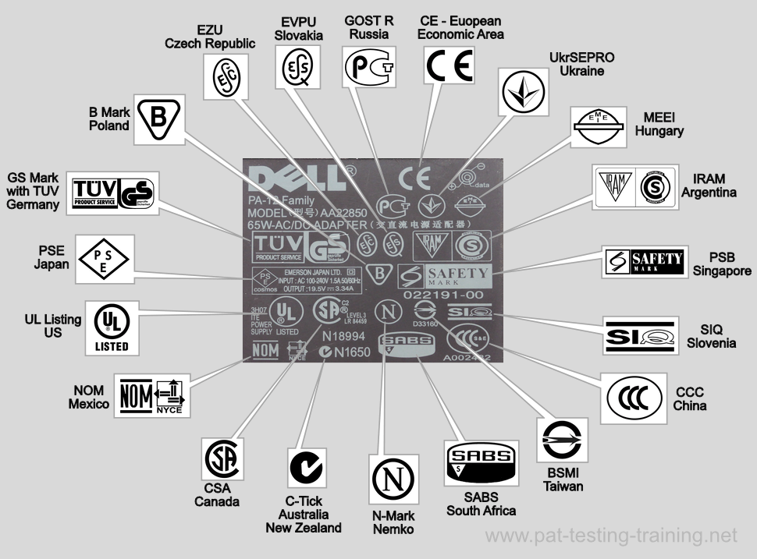
Notes:
45

Slide 46
Gulf Conformity Assessment Programs / Directives
ECAS?????
Emirates Conformity Assessment Scheme (ECAS)
Exporters/Importers trading with the United Arab Emirates need to comply with the requirements of the UAE Emirates Conformity Assessment Scheme (ECAS) for their goods to clear UAE Customs and for placing the products in the UAE Marketplace.
The ECAS prescribes requirements for quality and safety for regulated products including Cosmetics, Perfumery, and Personal Care Products Electrical, Electronic, and Gas Appliances, Machinery, Automotive, Building and Construction, and Food designated for consumer use. The ECAS certificate is proof that the product has been approved by the UAE Federal Government through MOIAT.
The EQM is a full assessment scheme and quality mark licensing program implemented by MOIAT. The EQM is an approved mark of quality issued for products that can demonstrate compliance to the relevant UAE technical regulations and standards, regional and/or international standards, and are manufactured by an organization implementing a Quality Management System ensuring continuous compliance.
Intertek has been appointed in the UAE as a Notified Body for Low Voltage Equipment (LVE), Energy Efficiency Standards Labelling (EESL), lighting regulation, regulation for restriction of hazardous substances (RoHS) and equipment used in explosive atmospheres (ECAS Ex), Cosmetics, Perfumery and Personal Care Products (TR UAE GSO 1943) and is authorised to issue the mandatory Certificate of Conformity and/or Quality Mark on behalf of MOIAT.
Notes:
46

Slide 47
Gulf Conformity Assessment Programs / Directives
Certificate of Inspection for Exports to Egypt
Certificate of Inspection for Exports of Food to Egypt
Certificate of Conformity for Exports to Ethiopia
Certificate of Conformity for Exports to Gabon
Conformity Assessment Program of Export to Ghana
Certificate of Conformity for Exports to Iraq
Certificate of Conformity for Exports to Ivory Coast
Certification of Products for Exports to Kazakhstan and the Customs Union
Certificate of Conformity for Exports to the Kurdistan Region
Conformity Assurance Scheme for Exports to Kuwait (KUCAS)
Certificate of Conformity for Exports to Morocco
Certificate of Conformity for Exports to Mozambique
Certificate of Conformity for Exports to Qatar
Certificate of Conformity for Exports of Food to Qatar
Certification of Products for Exports to Russia and the Customs Union
Saudi Product Safety Programme SALEEM SABER
Saudi Arabia Quality Mark - SASO
Certificate of Conformity for Exports of Cosmetics to Saudi Arabia
Certificate of Conformity for Food Exports to Saudi Arabia
Certificate of Inspection for Used Vehicles to Saudi Arabia
PVoC (Pre-Shipment Verification of Conformity) for Exports to Tanzania
Pre-Export Verification of Conformity for Exports to Uganda (PVoC)
Notes:
47

Slide 48
Conformity Assessment Process
Notes:
48

Slide 49
Conformity Assessment Process
Notes:
49

Slide 50
European Conformity Assessment Program CE Marking
Notes:
50

Slide 51
What is Conformity Assessment
Notes:
51

Slide 52
Notes:
52

Slide 53
Notes:
53

Slide 54
Notes:
54

Slide 55
Notes:
55

Slide 56
Notes:
56

Slide 57
Notes:
57

Slide 58
Notes:
58

Slide 59
Notes:
59

Slide 60
Notes:
60

Slide 61
Notes:
61

Slide 62
Notes:
This slide gives benefits or value of an EMS. (see also ISO 14004:2015)
What is the opinion of the delegates? Does anyone have a success story to share?

Slide 63
Notes:
This slide gives benefits or value of an EMS. (see also ISO 14004:2015)
What is the opinion of the delegates? Does anyone have a success story to share?

Slide 64
Notes:
This slide gives benefits or value of an EMS. (see also ISO 14004:2015)
What is the opinion of the delegates? Does anyone have a success story to share?

Slide 65
Notes:
This slide gives benefits or value of an EMS. (see also ISO 14004:2015)
What is the opinion of the delegates? Does anyone have a success story to share?

Slide 66
Notes:
This slide gives benefits or value of an EMS. (see also ISO 14004:2015)
What is the opinion of the delegates? Does anyone have a success story to share?

Slide 76
https://eucertification.net/check-certificate/
Or Email
info@eucertification.net

