Slide 1
ISOQAR PAKISTAN
Grow your business with ISO certification

Slide 2
About the Presenter
Director Operations - ISOQAR Pakistan
Chaudhry Abdul Jabbar has over twenty years of experience as Sr. Lead Auditor, Lead Trainer, QHSE Professional
IRCA registered Lead Auditor for
Quality Management System ISO 9001:2008/2015,Environmental
Management System ISO 14001/2004/2015, OH & S Management
System ISO 45001:2018.
Lead Auditor for Food Safety Management System & Food Safety System Certification ISO 22000 & FSSC 22000
IRCA approved Tutor for QMS as well as IMS Internal Auditing
Advanced Auditor & Lead Auditor Courses for ISO 13485 Medical Devices Quality & Social Management Systems.

Slide 3
About the Presenter
Mr. Abdul Jabbar has conducted more than 6500 man days Third-Party Certification Audits and has taught Lead Auditor courses in house as well publicly including leading Organizations like Supreme Fuels Germany/UAE , Pakistan Atomic Energy Commission, Pakistan Ordinance Factories (POF), NESCOM ISLAMABAD, Descon Engineering, Pakistan State Oil , Maple Leaf Cement Pakistan , etc. He has conducted more than two hundred public as well in-house QHSE training sessions, has developed Integrated Management Systems (IMS) in Food , Textile, Leather . Wood Products, Rubber & Plastic Industry, Concrete & Cement Industry, Surgical , Sports , Chemical & Fertilizers, Oil & Gas, Heavy Engineering, CNG & LPG, Telecommunication, Textile, Academic, Hospitals , Machinery & Equipment , Construction , Education and service sectors.
He also has good command over Corporate Social Responsibility (CSR) standards, ISO/TS 16949 (Automobile Technical Specification), ISO 17024 (Personnel Certification), ISO 50001 (Energy Management System), ISO 22000 (Food Safety Management System), ISO27001 (Information Security Management System) and ISO 17025 (Laboratory Accreditation), ISO 13485 (Medical Devices), CE Mark.

Slide 4
ISOQAR Presence in Pakistan
Sialkot
Lahore
Karachi
Islamabad /Rawalpindi

Slide 5
Virtual Locations
www.isoqarpk.com & www.isoqar.pk https://www.facebook.com/isoqarpakistan/
https://www.instagram.com/isoqarpk/?hl=en
Abdul.jabbar@isoqarpk.com
+92-333- 434 9654

Slide 6
Company Profile Contd….
Conceived in the late eighties, ISOQAR UK became a Limited Company in August 1991. It now enjoys one of the broadest scopes of Accreditation in the industry.
In October 2010 ISOQAR was acquired by the Alcumus Group, a multi-disciplinary provider of risk management, compliance and certification services (www.alcumusgroup.com).
Today ISOQAR has its own regional auditors throughout the world including UK and Pakistan and a network of operations in more than eighty (80) countries.

Slide 7
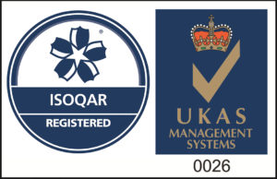
Company Profile
ISOQAR Certification Pakistan is accredited by the United Kingdom Accreditation Services (UKAS) and Pakistan National Accreditation Services (PNAC).

Slide 8
Services
Audit
Certification
Training & Capacity Building
Inspection

Slide 9
Certification we offered
ISO 9001 - Quality Management System
ISO 14001- Environmental Management System
ISO 45001 - Occupational Health & Safety Management System
ISO 27001 - Information Security Management System
ISO 22301 - Business Continuity Management System
ISO 13485 - Medical Devices Quality Management System
ISO 5000 - Energy Management System
ISO 29001 - Quality Management Oil & Gas

Slide 10
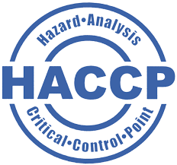
Certification we offered
BRCGS - Brand Reputation through Compliance
FSSC - Food Safety System Certification
IFS - International Featured Standard
HACCP Hazard Analysis and Critical Control Points
ISO 22000 - Food Safety Management System
Halal - Halal Certification

Slide 11
Training
ISO 9001:2015 Foundation Course
ISO 14001:2015 Foundation Course
ISO 45001:2018 Foundation Course
ISO 22000:2018 Foundation Course
IMS (9K,14K & 45K) Foundation Course
QMS ISO 9001:2015 Internal Auditor Course
EMS ISO 14001:2015 Internal Auditor Course
OHSMS ISO 45001:2015 Internal Auditor Course
ISO 22000:2018 Internal Auditor Course
IMS (9K,14K & 45K) Internal Auditor Course
BRCGS Global Standard Food Safety Foundation Course
FSSC Foundation Course

Slide 12
Certification Process Contd….

Slide 14
ISO Certification Cycle

Slide 15
Transfer your ISO Certification to ISOQAR
Transfer to one of the UK’s most recognised UKAS accredited certification providers, Alumnus ISOQAR today
Transferring from your current accredited certification body is easy. We ensu​re there’s no break in your certification and no disruption to your current audit schedule. Transferring does not require any additional audits.

Slide 16
How Transfer of ISO Certification works from other CB’s
Contact us
Call /email us, and submit a form (Questionnaire) to start the transfer process.
We review
Supply us with copies of your most recent audit report(s), certificate and some basic details. We will review and prepare your quote for future audits.
Audit
If you accept our proposal, Audit will conducted
You get your certification
You’ll be issued with your Alcumus ISOQAR certificate

Slide 17
Main Advantages of Working with ISOQAR Pakistan
An independent, third-party certification body
UKAS Accreditation
Accepted Worldwide
Global Recognition
Customer focus
Save Time & Money
No Hidden Costs
Free to Join - if you transfer and we do the paperwork
Broadest scopes of Accreditation in the industry
Own regional Auditors throughout the world including Pakistan
Network of operations in more than eighty (80) countries

Slide 18
Accreditation
UKAS - United Kingdom Accreditation Services
PNAC - Pakistan National Accreditation Services

Slide 19
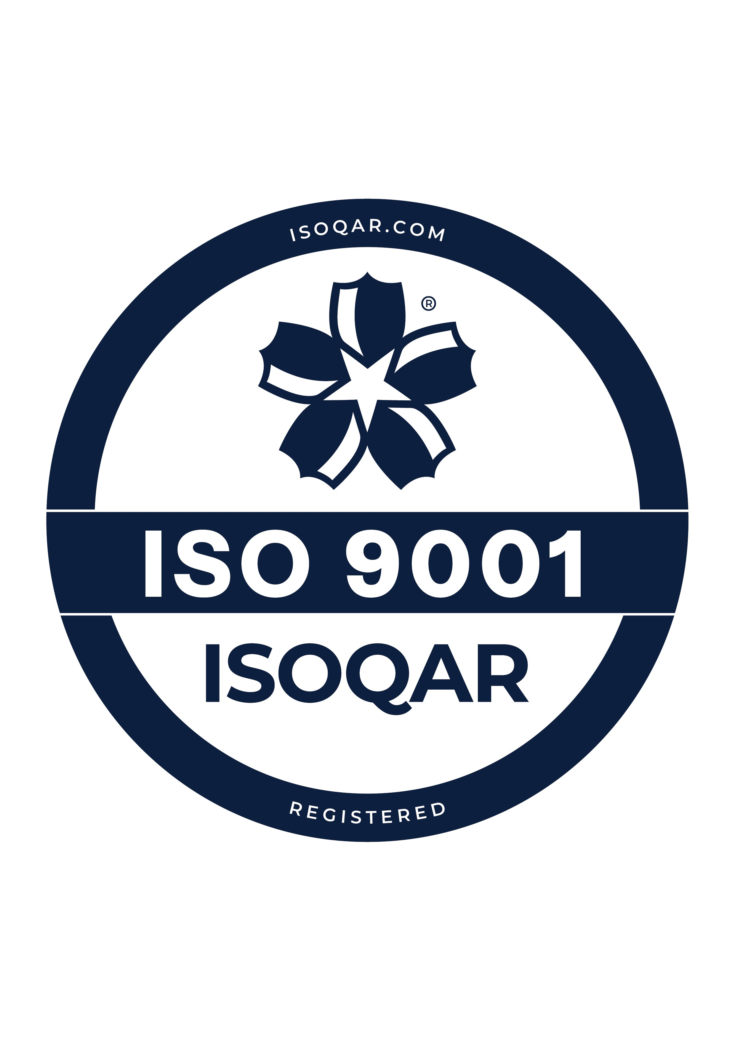
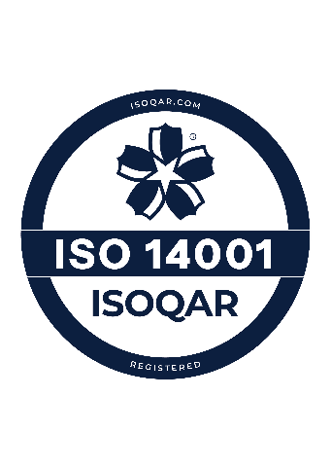
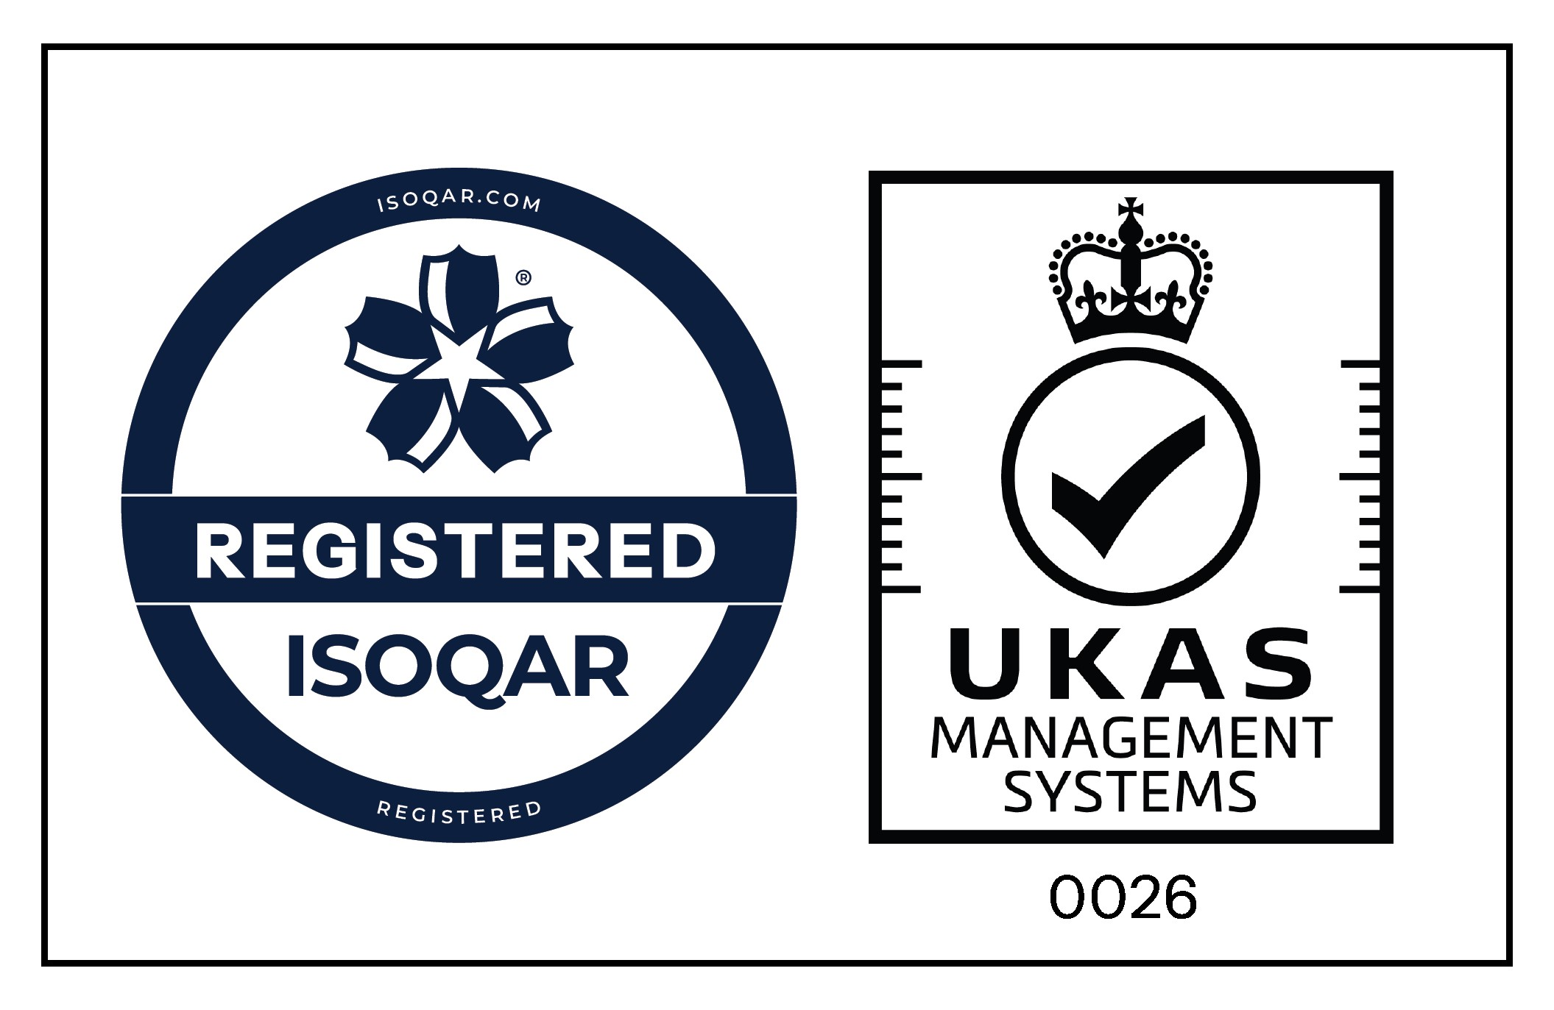
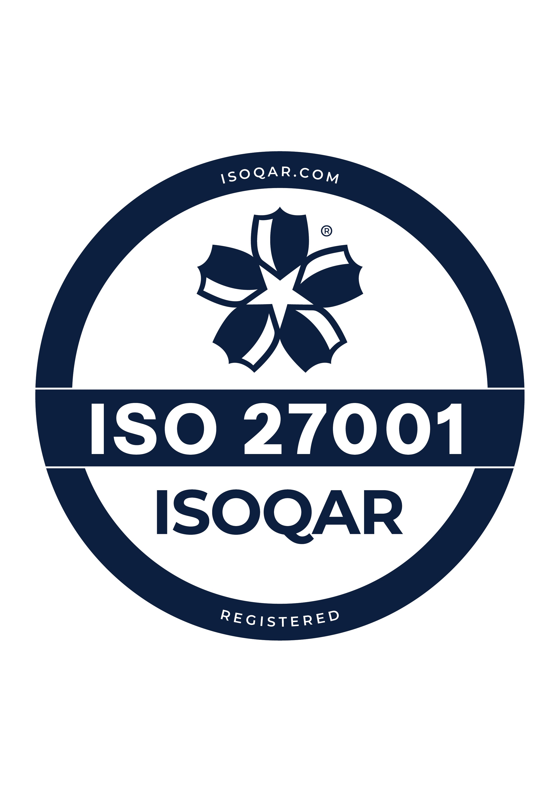
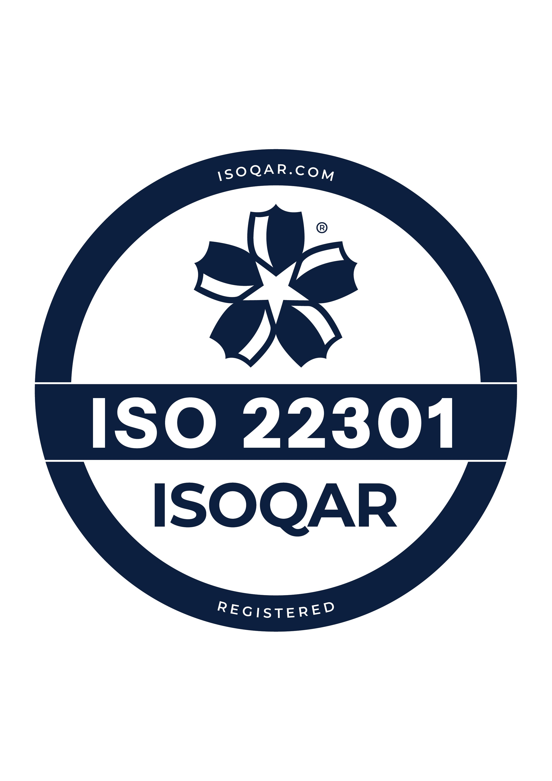
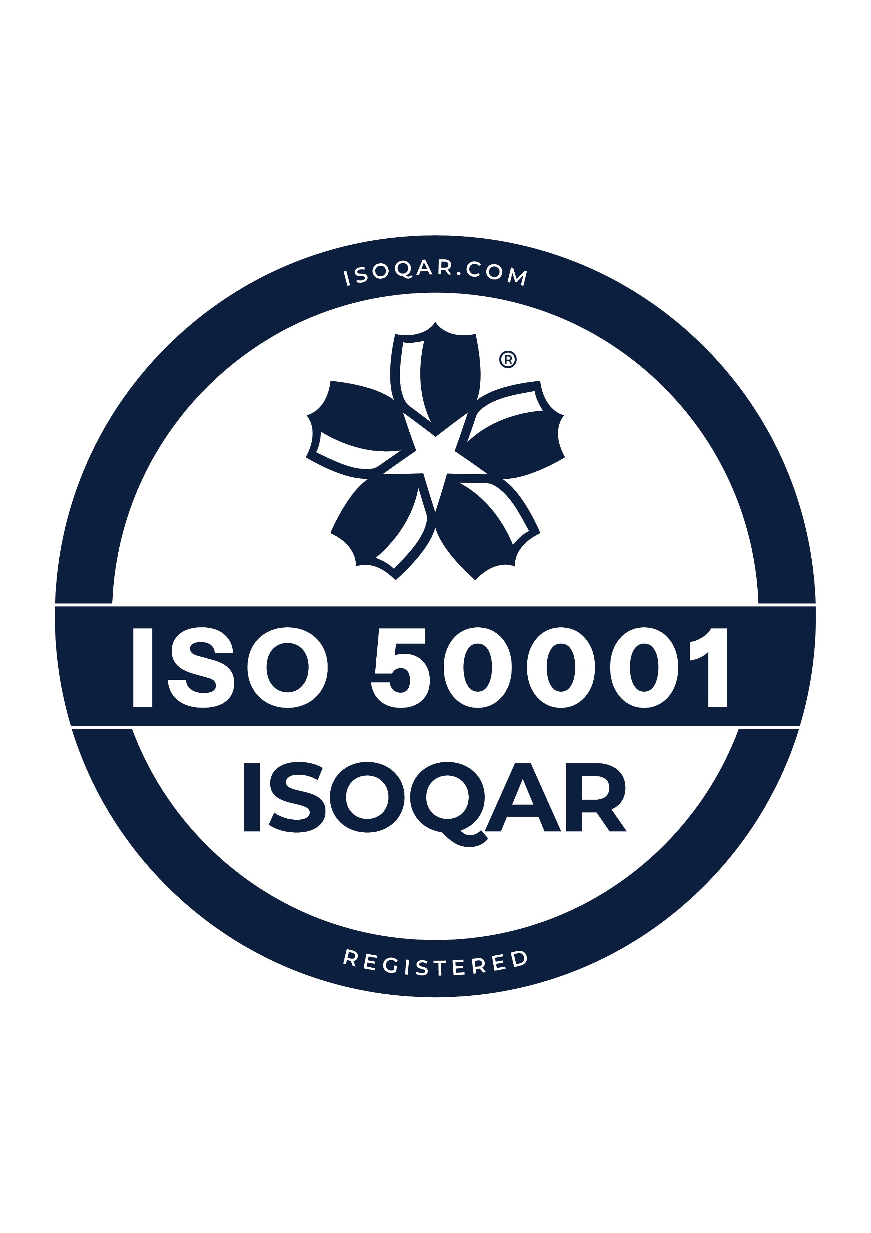
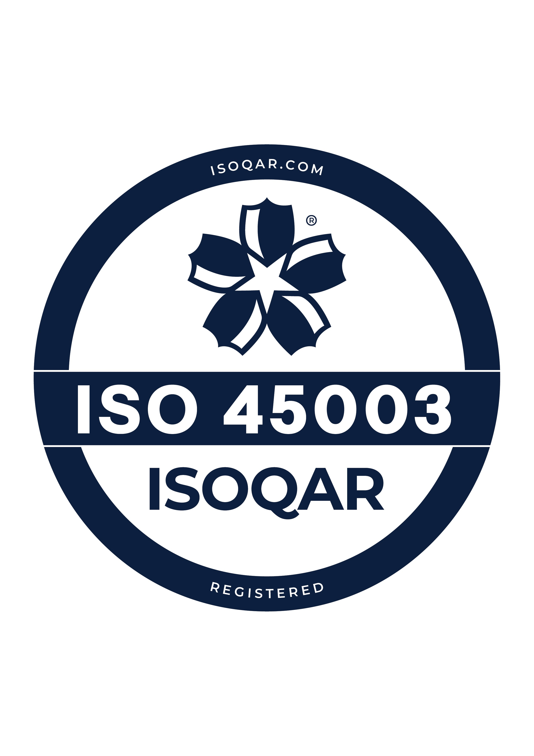
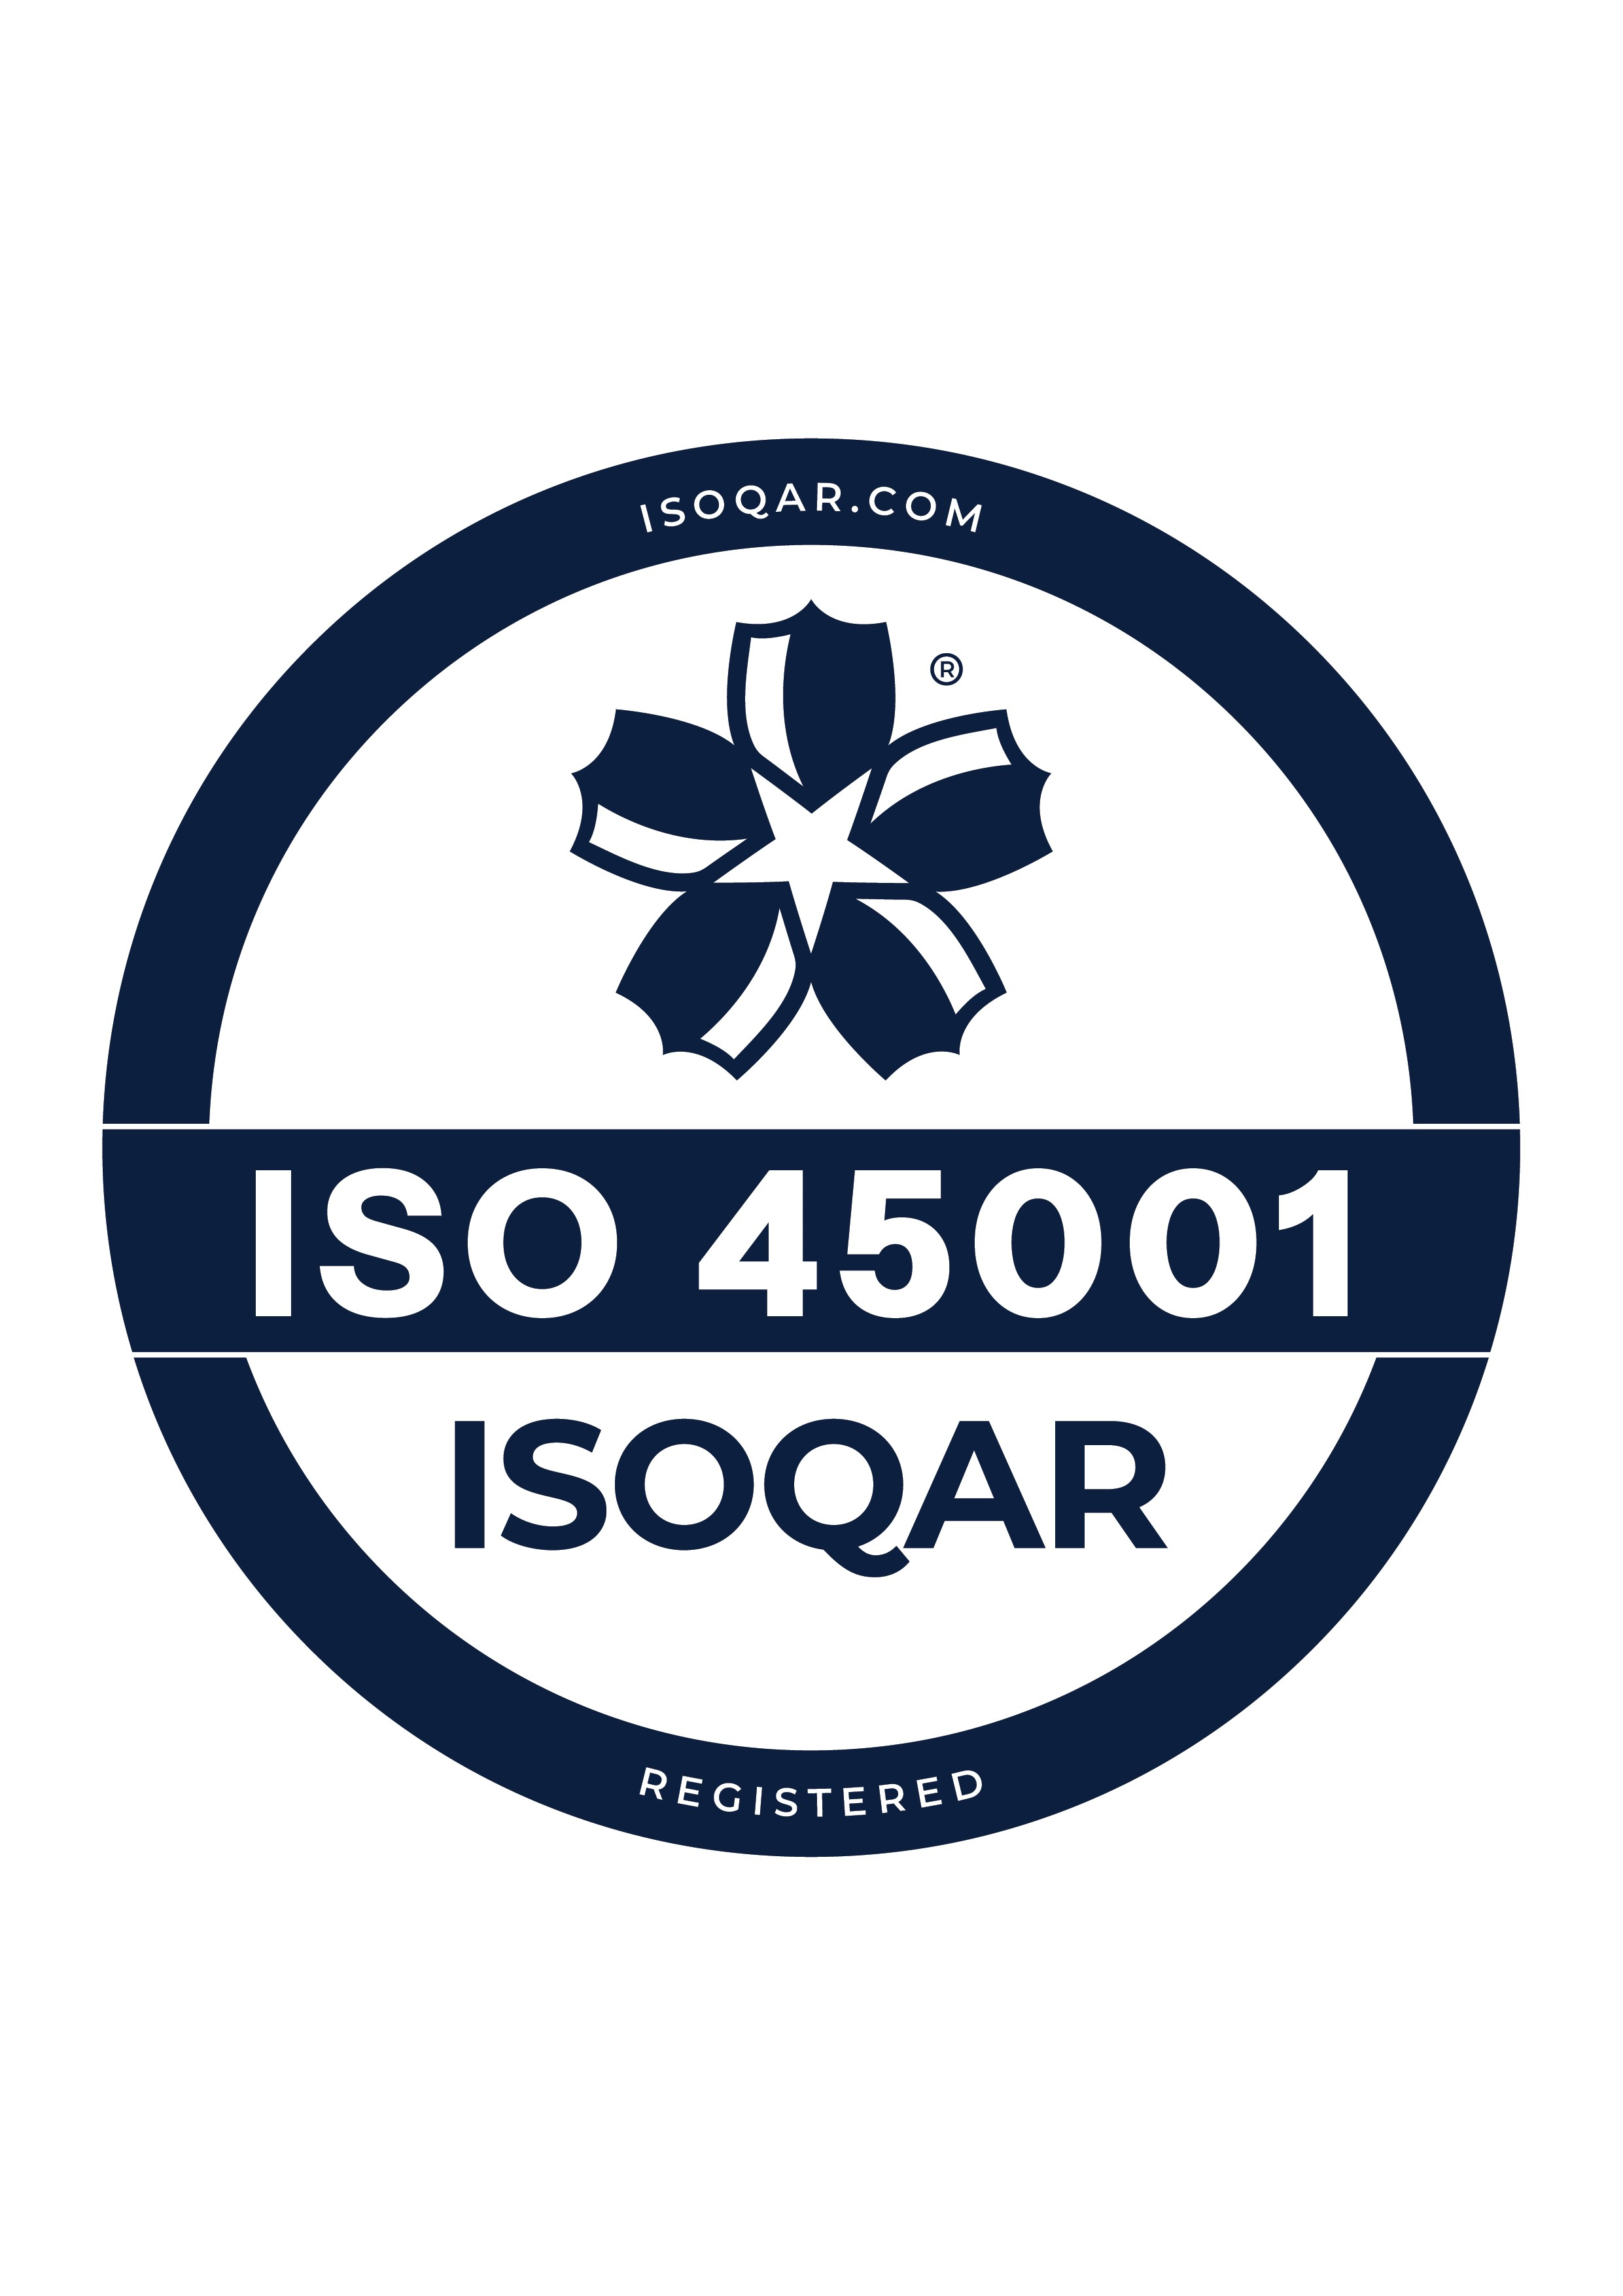
ISOQAR Logos/Accreditation Marks

Slide 20
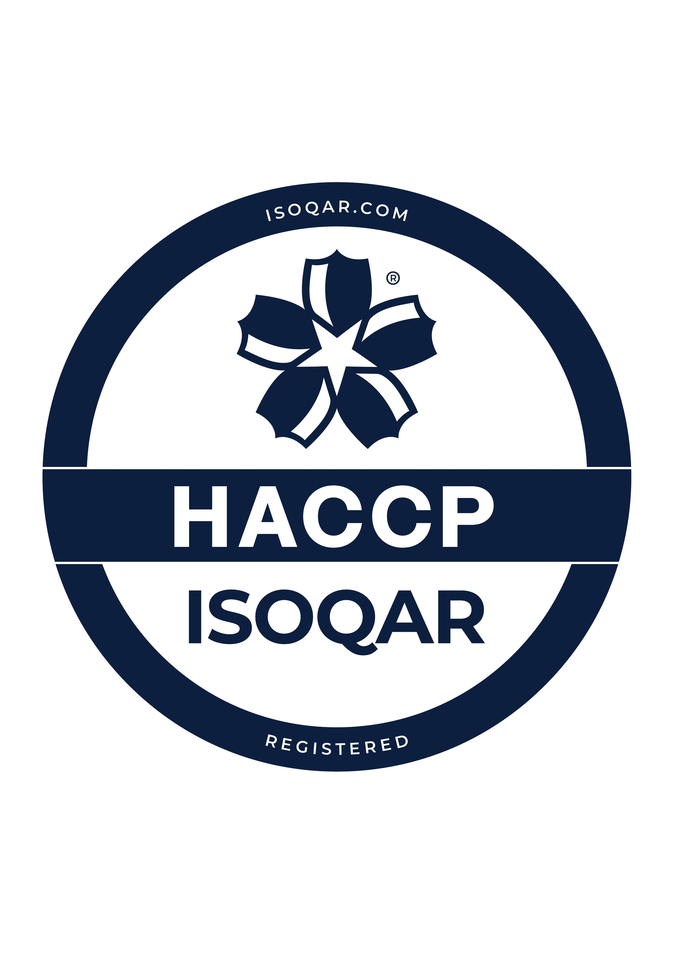
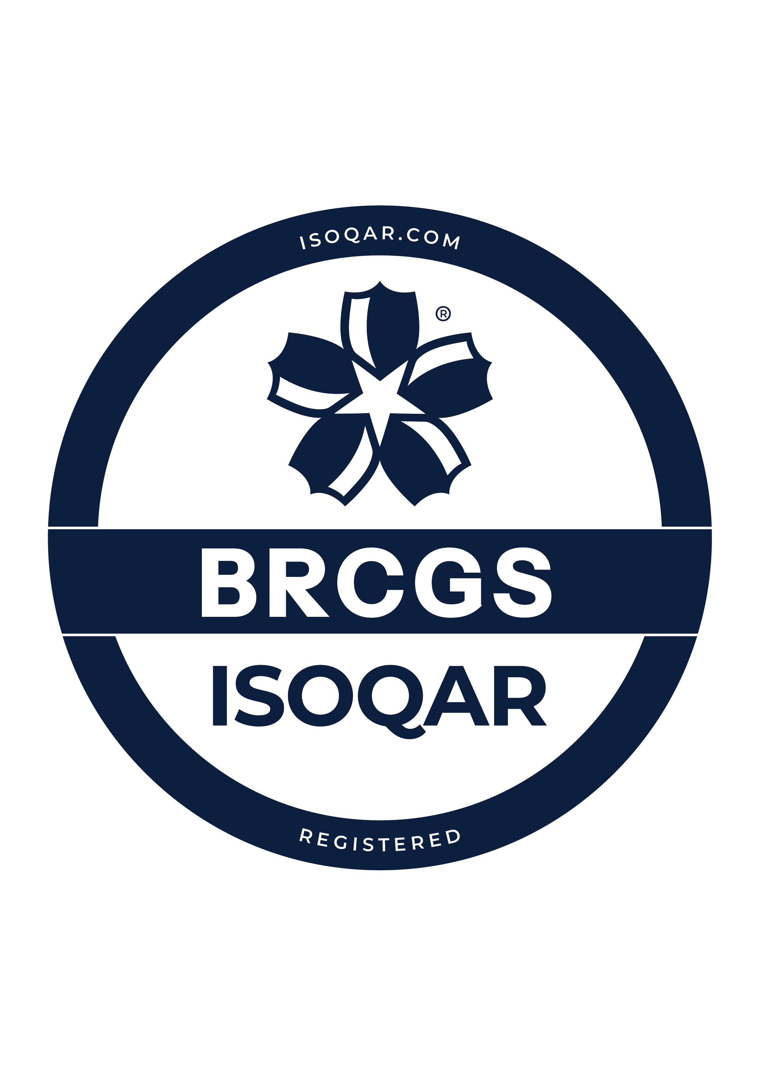
ISOQAR Logos/Accreditation Marks

