Slide 1
Islamic Banking Awareness Session
Mufti Khawaja Noor ul Hassan
Resident Shariah Board Member
HabibMetro Sirat Islamic Banking
MA, LLB, Advocate High Court, Certified Director, Registered Shariah Advisor (SECP), Visiting Faculty Member at Institute of Business Administration (IBA), NIBAF (SBP),
Jamia tur Rasheed & Jamia Yousufia Binnoria
STAY AHEAD
Classification: Public

Slide 2
Speaker’s Profile
Mufti Khawaja Noor ul Hassan presently working as the Resident Shariah Board Member at HabibMetro – Sirat Islamic Banking. He has extensive professional experience in Islamic banking including but not limited to Shariah governance & compliance, Islamic product development and management, conversion of conventional banking branches/windows/ assets/liabilities into Islamic banking products with its relevant documentation, credit administration with prestigious institutions such as Saadiq, Standard Chartered Bank (Pakistan), Faysal Bank, Meezan Bank & Albaraka Bank (formerly Emirates Global Islamic Bank). He also has over 03 years experience, working as corporate law consultant & Assistant company secretary.
Mufti Noor ul Hassan is also a Certified Director, as per Code of Corporate Governance, Securities & Exchange Commission of Pakistan (SECP) and registered Shariah advisor at the Securities and Exchange Commission of Pakistan (SECP). He is the first Shariah scholar & registered Shariah advisor to have this certification of Certified Director conducted through IBA, Karachi. He is also enrolled as an advocate, High Court, Karachi and is a member of Sindh Bar Council and Karachi Bar Association. He has vast teaching experience of religious and Islamic banking courses in different institutions such as in Jamia Yousufia Binnoria, Jamia tur Rasheed, NIBAF (SBP), IBA CEIF, Centre of Islamic Economics (a division of Jamia Darul Uloom, Karachi), Iqra University, Themis School of Law & others.
Mufti Noor ul Hassan possesses both contemporary & religious qualifications. He holds the Shahadat-ul-Aalamia and Takhassus fil-Ifta (Specialization in Islamic Jurisprudence and Fatwa) from Jamia Farooqia & Jamia Darul Uloom, Taleem ul Quran, Karachi. He also holds a Bachelor’s degree in Law (LLB), a Master’s degree in Islamic Studies, and a Master’s degree in Islamic History from the University of Karachi & Federal Urdu University respectively.
STAY AHEAD
Classification: Public

Slide 3
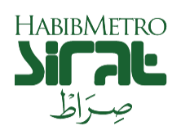
Outline
Verses of Quran Majeed
Definition of Riba
Overview between Conventional & Islamic Banking
Glance on HabibMetro – Sirat
Controls in Islamic Banking

Slide 4
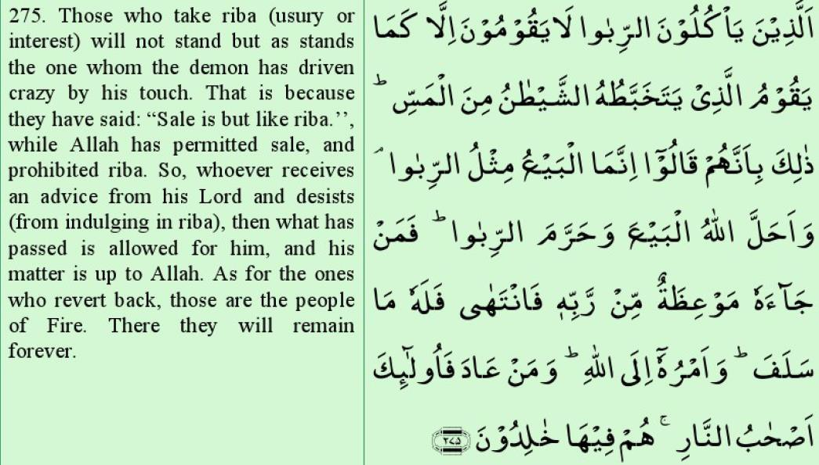
Quranic Verse: Prohibition of Riba

Slide 5
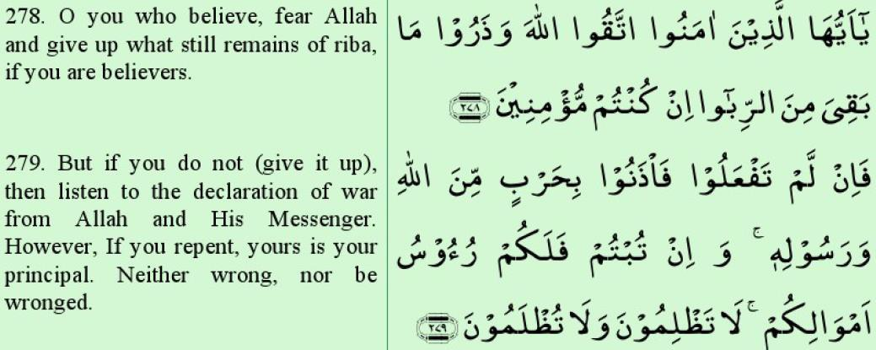
Quranic Verse: Prohibition of Riba

Slide 6
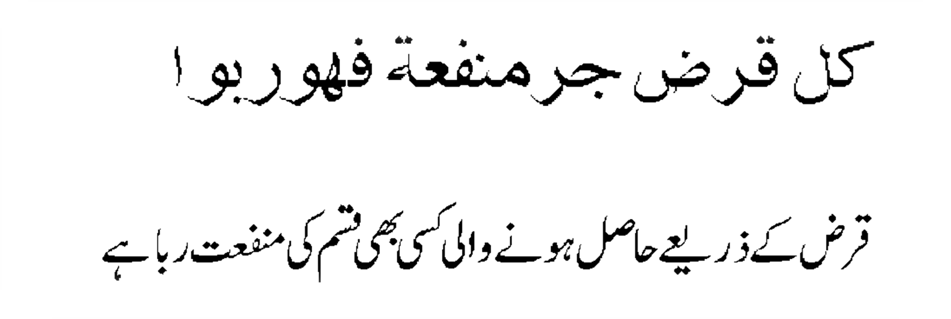
Definition of Riba
Any type of gain derived from a debt contract is Riba.

Slide 7
Overview between Conventional & Islamic Banking
Conventional Banking | Islamic Banking
Deposits Side
1. The bank guarantees all its deposits/returns. | 1. The bank only guarantee deposits for Current Accounts (Qard based). In saving accounts / Islamic investment certificates, the relationship is on partnership basis (Mudarabah), so loss if any will be borne by the investor(s).
2. In savings accounts / terms certificates, the depositor gets a predetermined fixed return. | 2. In savings accounts/Islamic investment certificates, the depositor does not get a predetermined fixed profit and expected rate may be quoted based upon the historical business performance, but as per Shariah principles, this expected rate is and cannot be guaranteed.

Slide 8
Overview between Conventional & Islamic Banking
Conventional Banking | Islamic Banking
Asset Side
1. Transactions are loan based | 1. Transactions are asset based, as applicable
2. Primary Business is earning through lending. | 2. Primary function is earning through (a) Trade (sale and purchase) of assets (b) Rental income (c) Fee for services (d) Acting as an agent on behalf of its customers.
3. Late payment penalty and compounded interest can be charged in case of delay in repayment. | 3. The bank cannot charge late payment penalty in case of delay in payments. Charity Amounts are given by the customer as per their undertaking to pay an amount as charity which is only applicable for habitual customers or without any non- genuine reaons.

Slide 9
Overview between Conventional & Islamic Banking
Conventional Banking | Islamic Banking
Asset Side
4. In case of late repayment, the penalty becomes part of bank’s income. | 4. The charity (if demanded by the Bank) given by the customers does not become part of bank’s income, not utilized on Bank’s staff welfare and is only utilized by the Bank on behalf of the customer for social welfare purposes with proper disclosure in the bank’s annual accounts.
5. The relation of a conventional bank to the client is as creditor and debtor. | 5. The relation of Islamic bank to the client is as partners, investors, trader, buyer and seller.

Slide 10
Overview of a conventional bank’s main functions
Customer/
Depositor
Loans
Loans
Borrower
Banks
Conventional Bank
Repayment of Loans
Withdrawals
Interest Payment
Interest Payment

Slide 11
Overview of an Islamic bank’s main functions
Customer/ Depositor
Qarz /
Trade / Rent
Banks
/ Service
Customer
Mudaraba
Islamic Bank
Payment-Profit/Rent
Withdrawals
Profit Payment
Profit/Rent Payment

Slide 12
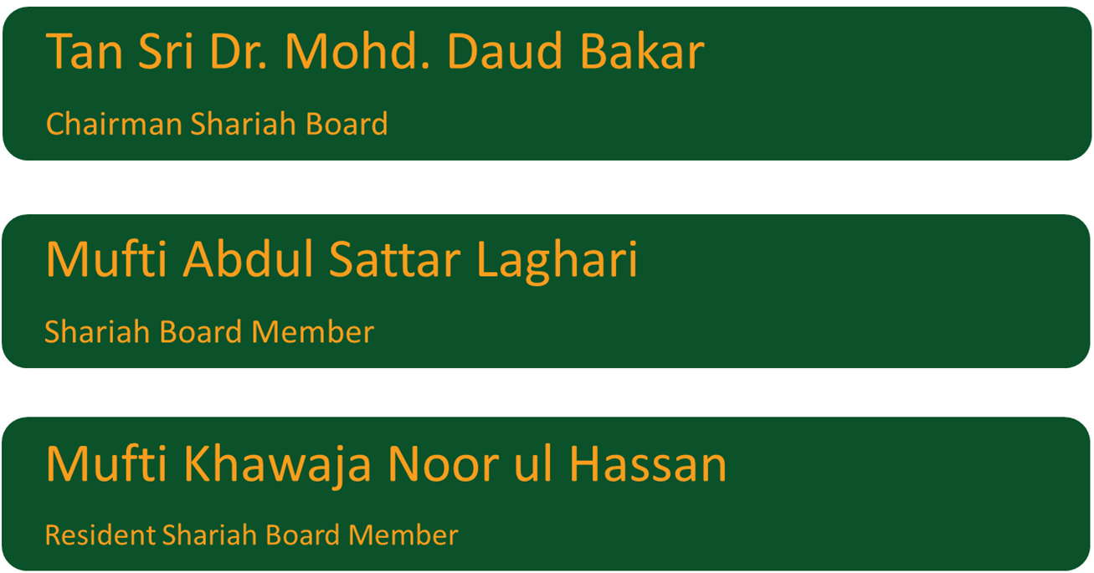
Shariah Board Members at HabibMetro SIRAT
Classification: Public

Slide 13
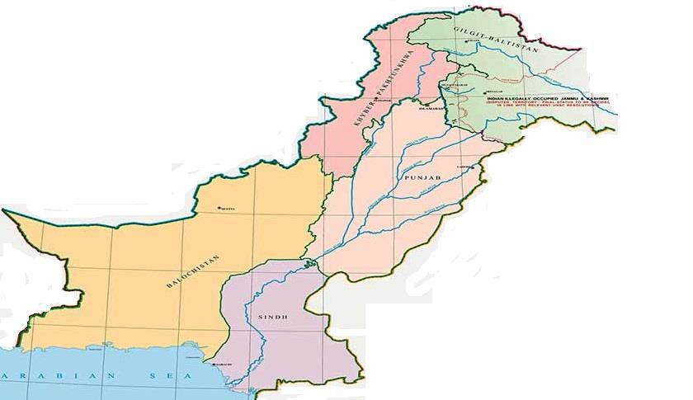
Sirat’s Branch Network
Khyber Pukhtunkhwa
Islamic Network
116 Islamic Branches
217 Islamic Banking Windows
Baluchistan
Islamabad – Federal Capital
Punjab
Sindh
Classification: Public
11

Slide 14
Deposit Products | Asset Products
Current Accounts (Qard based) Current Account Super Current Account Current Plus Account Asaan Current Account RDA Account Ladies Current Account Saving Accounts (Mudarabah based) Savings Account Junior Savers Account Non-Resident PKR Saving Account PLS Financial Institution Account PLS Plus Account PLS Premium Account Privilege 55+ Account RDA Savings Account Asaan Saving Account Basic Banking Account Ladies Savings Account Habib Islamic Investment Certificate (Mudaraba based) Classification | Fund Based Financing Murabaha Istisna Al-Bai Salam Currency Salam Working Capital Musharakah IERS (AlBai/Istisna/Salam/Murabaha/WCM) Diminishing Musharakah Ijarah Consumer Products SIRAT House Finance Mera Pakistan Mera Ghar Insta Car - Consumer : Public

Slide 15
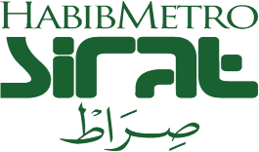
Islamic Deposit Products
Current Accounts
The Islamic current account products are offered on the basis of Qard where the principal amount of the customers are guaranteed.
Saving Accounts/Islamic Investment Certificates
The Islamic saving products are offered on the basis of Mudaraba, where the Bank acts as Mudarib and the account holder acts as Rabb-ul-Maal. The profit earned on Mudaraba based products is distributed as per the pre-determined profit sharing ratio and weightages.

Slide 16
Islamic Banking General Working Model
Deposit Side Saving Deposits - Mudarabah Term Deposits - Current Qard Account Deposits - | Flow of Funds Rabb-ul-Maal Equity | Asset Side Mudaraba ^{Wakala} Istisna _{Musharaka} Musawamah Diminishing Musharaka Murabaha Ijarah Salam

Slide 17
Islamic Banking-Thumb Rules
Shariah Compliant Contracts
No Interest Income
No Prohibited Items

Slide 18
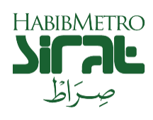
Controls in Islamic Banking Institutions
How it is ensured that all the Islamic banking operations are executed as per the Shariah principles?
Certain & additional controls are present in Islamic Banks such as:
Shariah Board with one of its member as Resident Shariah Board Member
Shariah Compliance Department
Internal Shariah Audit
External Shariah audit
Inspections of Islamic Banking Department, State Bank of Pakistan

Slide 19
Q & A

Slide 20
Thank you

